Slide 1

2021 ATFS Standards Inspector Training
Date
Facilitator
Location

Slide 2

Workshop Agenda
Review of American Tree Farm System
2021 Standards & Guidelines
Inspection Procedures and Protocols
Tree Farm Program Participation
Review & next steps
Notes:
Time: 1/2 min
Materials: Provide a detailed agenda that gives the schedule for the day, including times for breaks, lunch, activities and so forth. Post conspicuously or distribute to participants.
Consider assigning a Time Keeper to keep you on schedule.

Slide 3

Anti-Trust statement
“if a questionable topic is about to be discussed in connection with any gathering, whether or not a formal meeting, that discussion should be immediately stopped and not resumed until approved by legal counsel.”
Notes:
Read the anti-trust statement in full:
“POLICY STATEMENT ON COMPLIANCE WITH ANTITRUST LAWS
Fair and vigorous competition is essential to the maintenance of this country's free enterprise system. In furtherance of this principle, all activities are to be conducted in strict compliance with antitrust laws. Staff, officers, directors, members, and committee members are reminded that they are required to comply with the spirit and requirements of the antitrust laws.
A free exchange of ideas on matters of mutual interest to representatives of the forest community and others is necessary for the success of all meetings. Such an exchange of
views is essential to the success of each meeting. It is not the purpose of this policy to discourage the exploration in depth of any matters of legitimate concern to meeting
participants. Nevertheless, to ignore certain antitrust ground rules, either through ignorance or otherwise, is to create a hazard business people cannot afford.
The Sherman Antitrust Act, the Clayton Act, the Federal Trade Commission Act, and the Robinson-Patman Act compromise the basic federal antitrust laws, which set forth the broad areas of conduct considered illegal as restraints of trade. In general, agreements or understandings between competitors that operate as an impediment to free and open
competition are forbidden. The broad language of the Clayton Act suggests the scope of federal antitrust prohibitions by forbidding any "agreement or understanding . . . to
substantially lessen competition or trend to create a monopoly in any line of commerce.“
This is, at best, only a general outline of some of the areas that pose antitrust dangers in discussions between competitors and between sellers and their customers. They are provided to guide discussion during meetings, and in connection with social or other gatherings on those occasions.
If any question arises about an item on a meeting agenda, it should be reviewed by legal counsel before the meeting. If the question does not arise until the meeting has begun, or if a questionable topic is about to be discussed in connection with any gathering, whether or not a formal meeting, that discussion should be immediately stopped and not resumed until approved by legal counsel.”

Slide 4

Introductions
Virtual Introductions- Breakout Rooms
  Name
  Company or Organization
  Current or New facilitator
  Role in your states Tree Farm Committee
Notes:
Time: 10 Minutes
Materials: Icebreaker for introduction
Introductions:
The Workshop Leaders
All Participants: Name, Organization and ATFS experience, favorite tree by genus & species or other icebreaker
Presenter – write names for use later in involving people in discussions.

Slide 5
The American Tree Farm System
Notes:
Time: 10 Minutes
Materials: Icebreaker for introduction
Introductions:
The Workshop Leaders
All Participants: Name, Organization and ATFS experience, favorite tree by genus & species or other icebreaker
Presenter – write names for use later in involving people in discussions.

Slide 6

The American Tree Farm System is a program of the
American Forest Foundation
ATFS works with family forest landowners to provide:
-education
-professional resources
-certification
-recognition
-representation
Notes:
Time: 1/2 min
Materials: none
The American Tree Farm System is a program of the American Forest Foundation.

Slide 7
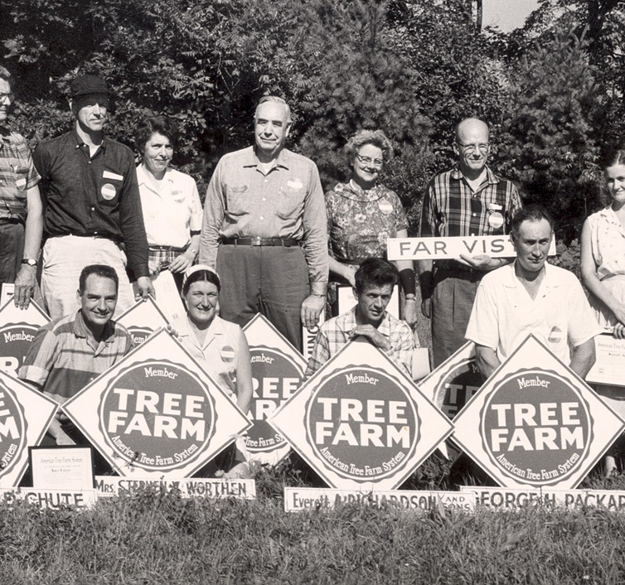

The history of ATFS
The term ‘tree farming’ was first used ~1940 as a term for sustainable forestry.
1941- 1st Tree Farm is established on Weyerhaeuser property in Washington State to prove that private owners can manage forestlands
In 2000 the American Tree Farm System became a certification organization and developed the first set of mandatory Standards of Sustainability
Notes:
‘Time: 3 min
Materials: none
History and Introduction
The term “tree farming” was first used about 1940 to introduce the public to sustainable forestry terminology they could easily understand.
The first Tree Farm was established in 1941 by Weyerhaeuser in Montesano, WA as a demonstration area to highlight good forestry practices.
It was created, in part, to prove that private owners can properly manage forestlands and that government regulations or oversight of practices was not necessary.
Soon after state committees were started in Alabama, Arkansas, California, Oregon, and Washington where the focus became recognition of good stewardship on family forest lands. Additional state committees were established, and for nearly sixty years the American Tree Farm System (ATFS) grew and spread with few changes.
In the late 1980s, concerns resurfaced about the ability to sustainably manage forests, culminating with the United Nations convening the Rio Earth Summit in 1992. One outcome of the Summit was the determination of a need for guidelines to define sustainable forestry. A committee was appointed and over the next couple of years the Montreal Process Criteria and Indicators of Forest Sustainability were developed.
The Montreal Process is the basis for all current forest certification systems. By the late 1990s, the public demand for certified wood had reached a tipping point; people wanted to know that the wood products they used were not sourced in a way the harmed the environment. Tree Farm had reached a critical juncture; would it continue as a recognition program, or would it transition into a certification system?
By 1998, it was determined that, in order to remain relevant, the Tree Farm System needed to become a certification organization , and the 2000 Standards of Sustainability were soon developed. For the first time, written and active plans addressing water quality standards, wildlife considerations, recreational opportunities, and sustainable forest management were required.
es or charts on right

Slide 8
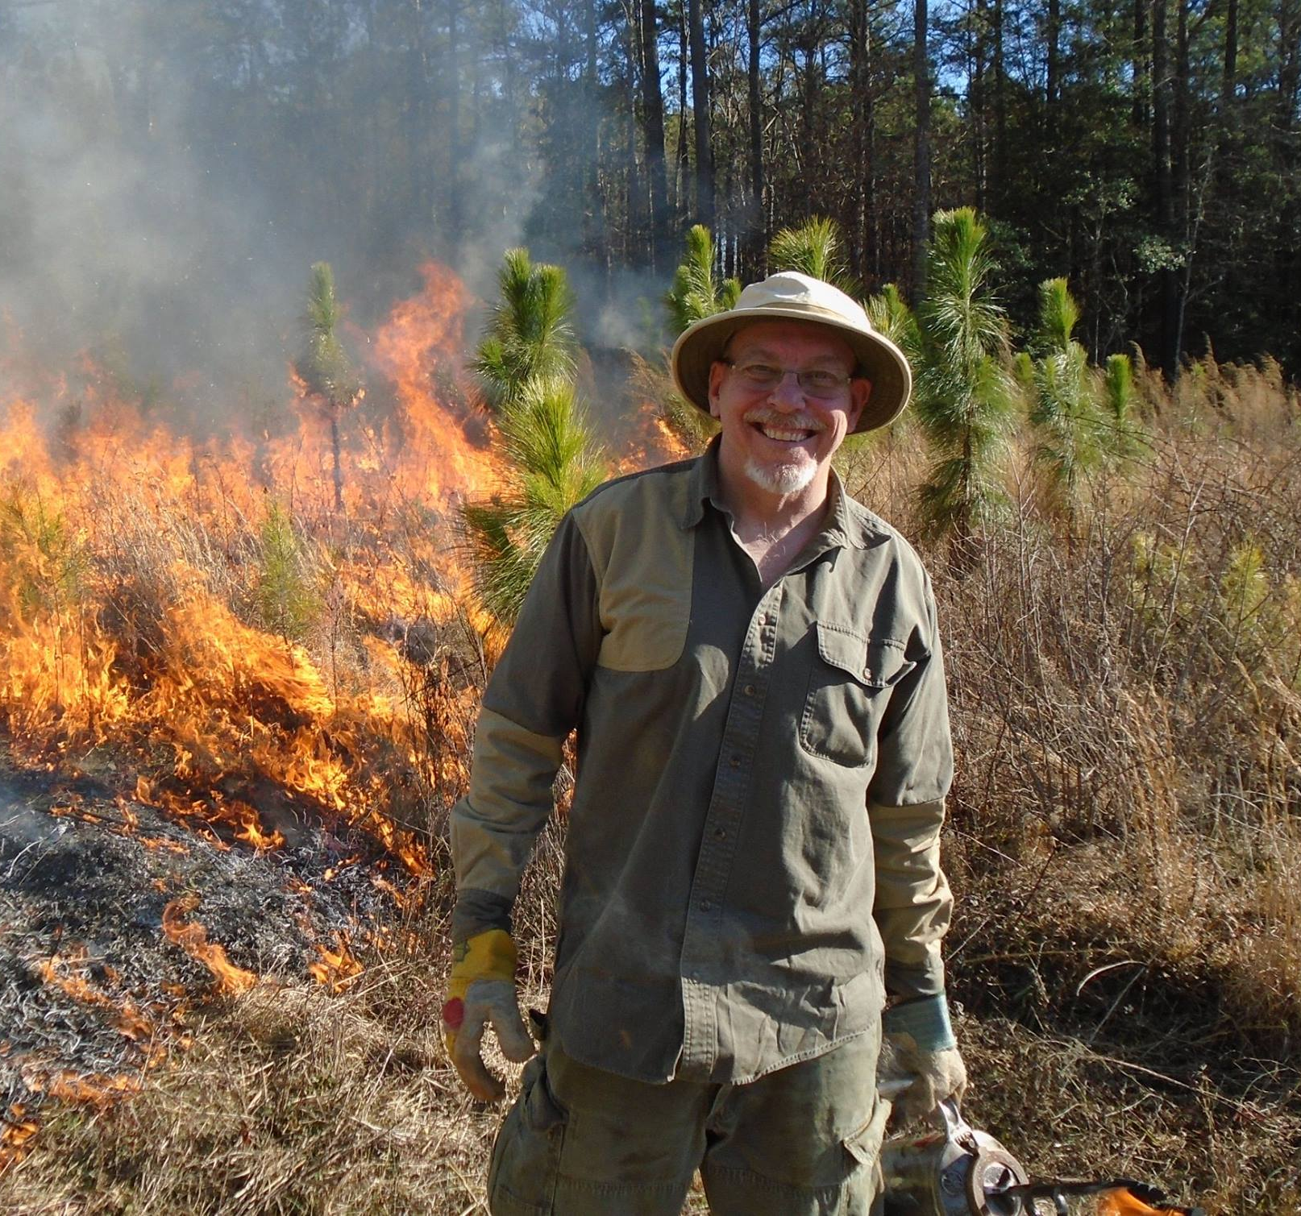
ATFS history cont’d
In 2000, SFI first recognized materials harvested from Certified Tree Farms as meeting their standards of sustainability
In 2008, PEFC, an international certification standard, recognized ATFS as meeting their benchmark standards for sustainability
Today, ATFS is the largest and oldest sustainable woodlands system in America.
Notes:
‘Time: 3 min
Materials: none
-Since 2000, the Sustainable Forestry Initiative (SFI) recognizes materials harvested from Certified Tree Farms as meeting their Standards for Sustainability.
-In 2008 the Programme for Endorsement of Forest Certifications (PEFC), the European Standard, recognized ATFS as meeting their standards for sustainability.
-Today, ATFS is the largest and oldest sustainable woodlands system in America. It is internationally recognized as the benchmark for certification of family forests, and is the primary vehicle for family forest owners to influence government policy and officials at the national level.

Slide 9
_____ State Tree Farm Program
Presenter to customize with state specific information
Key state contacts
# Tree Farms
# Acres
other info
Notes:
Time: 1 min
Materials: local Tree Farm brochures
Facilitator, add your state and local information here
A best practice hint: no more than 6 bullets and not more than 6 words per bullet
Items to consider including: Program size – Tree Farms and acres; key sponsors & supporters, state contacts

Slide 10
American Tree Farm System Mission:
“to promote the growing of renewable forest resources on private lands while protecting environmental benefits and increasing public understanding of all benefits of productive forestry”
Notes:
Time: ½ min
Materials: none

Slide 11
What does ATFS do?
-We work on the ground.
-We give people the tools they need.
-We focus on the future.
Notes:
Time: 1 Minute
Materials: none
You know the mission of Tree Farm, so what do we do? How do we accomplish the mission? What role do you play a volunteer inspector?
Through our Inspectors and the outreach and education of State Committees, we are boots on the ground, in the field helping forest owners learn by doing.
The American Tree Farm System gives people the tools they need to be effective stewards of America’s natural heritage by keeping their forests healthy and productive. These woodlands are vital to our country’s clean water and air, wildlife habitat, and recreational opportunities, and to producing the jobs, wood and paper products we all need.
The future is not just the sustainability of the trees, we work with families on intergenerational planning to keep the forest in the family and we work with policymakers to ensure that forests a viable option for the family lands.

Slide 12
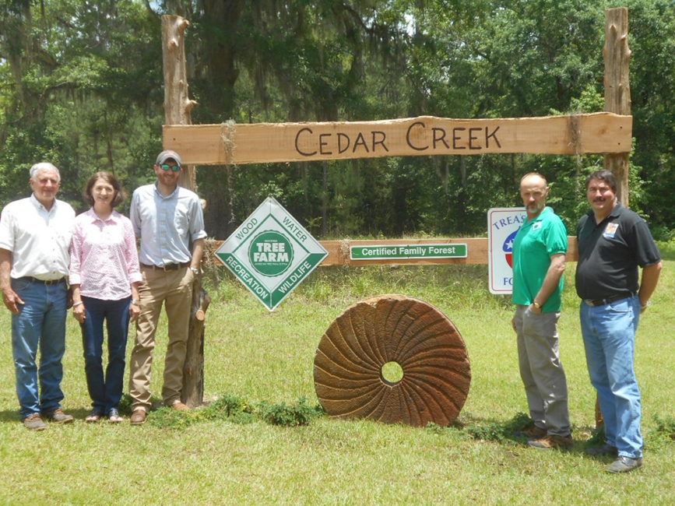
Why should a landowner become a Tree Farmer?
Community of like-minded people, learning from each other.
Proof of excellence through certification or recognition.
Stewardship of forestland for future generations.
Notes:
Time: 1 min Materials: brochures if available
Question for audience – We know why they own their property, we know what Tree Farm stands for. Why do you think people become Tree Farmers?
Certification: May not be appropriate for all state programs; if you are a recognition state eliminate this line. ATFS is the most economically viable certification option for small family forest owners. The reason we can offer this service is because of the commitment of you: our nationwide three thousand plus corps of inspecting foresters. Tree Farm is built on your professionalism; you provide the on-the-ground validation which is essential to Tree Farm’s integrity, and the confidence that this is an exemplary program. Today’s workshop certifies you as a qualified Inspecting Forester.
Recognition: Tree Farm recognizes landowners that practice sustainable forestry on their lands and rewards them with the Big Green Sign so that others will also know what they have achieved. We recognize excellence among these “best of the best” through the Outstanding Tree Farmer of the Year awards on the state, regional, and national level.
Community: Tree Farmers repeatedly state that what they value most is that the program is a community of like-minded people learning from each other.
Landowners become Tree Farmers for the same reasons you have chosen to be inspecting foresters – excellence, stewardship and community. The program is not a good fit for everyone, but it is a great reward for those that believe and achieve.

Slide 13
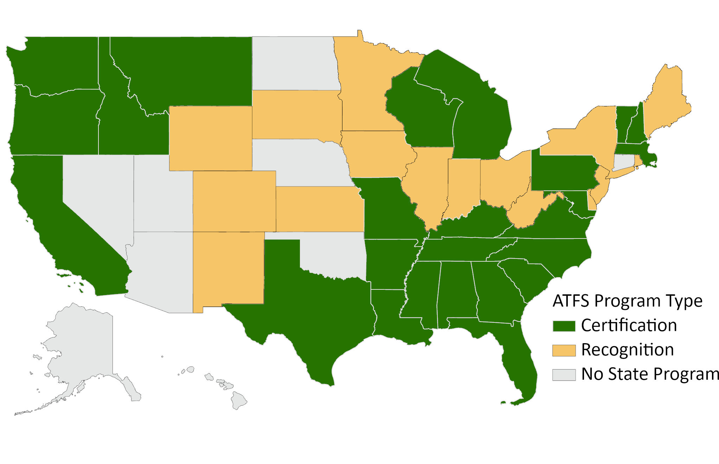

Certification and Recognition States
Notes:
Time: 1 min

Slide 14
ATFS Eligibility Requirements
2021 Standards of Sustainability
and Guidelines

Slide 15

ATFS Enrollment Options
State Program
Independently Managed Groups
Individual third-party
Notes:
Time: ½ Minute
Materials: 2021 Eligibility Requirements
This workshop allows you to certify the properties highlighted in yellow. The others are presented for information; anyone wishing to be certified in other options can contact the ATFS office.
ATFS Certifies properties between 10-10,000 contiguous acres through the State Tree Farm Program. Forest owners may choose to certify a portion of their entire property portfolio, but may not exempt a portion of a contiguous forest management unit that does not meet the AFF Standards. Forested acres may include features such as food plots, water resources (lakes, ponds, streams), and other non-forested areas as long as these are small enough that they are an integrated part of the forest system.
Contiguous – contiguous parcels are discrete parcels that share a boundary line or corner point and are held under the same legal ownership name. Non-contiguous parcels must have unique identifiers (separate Tree Farm numbers) but may be under a single management plan.
10,000 – 20,000 acres parcels may be eligible under the Independently Managed Group (IMG) or 3rd Party Certification, but in general, the Inspectors do not engage with these ownerships. If you do meet a landowner interested in ATFS certification of a property larger than 10,000 acres, contact the National Office to see if the options available through IMG or Third-Party Certificate may be a good for the landowner.

Slide 16
ATFS Enrollment
Who can I certify through the State Program?
  Individual owner, small business, public (except state)
  10-10,000 contiguous acres
Notes:
Time: ½ Minute
Materials: 2021 Eligibility Requirements
This workshop allows you to certify the properties highlighted in yellow. The others are presented for information; anyone wishing to be certified in other options can contact the ATFS office.
ATFS Certifies properties between 10-10,000 contiguous acres through the State Tree Farm Program. Forest owners may choose to certify a portion of their entire property portfolio, but may not exempt a portion of a contiguous forest management unit that does not meet the AFF Standards. Forested acres may include features such as food plots, water resources (lakes, ponds, streams), and other non-forested areas as long as these are small enough that they are an integrated part of the forest system.
Contiguous – contiguous parcels are discrete parcels that share a boundary line or corner point and are held under the same legal ownership name. Non-contiguous parcels must have unique identifiers (separate Tree Farm numbers) but may be under a single management plan.
10,000 – 20,000 acres parcels may be eligible under the Independently Managed Group (IMG) or 3rd Party Certification, but in general, the Inspectors do not engage with these ownerships. If you do meet a landowner interested in ATFS certification of a property larger than 10,000 acres, contact the National Office to see if the options available through IMG or Third-Party Certificate may be a good for the landowner.

Slide 17
Landowner Eligibility
Private or public ownership
No publicly traded companies
Nonindustrial (small business exception)
Agree to conform to Standard
Agree to participate in assessments
Notes:
Time: 1 Minute Materials: 2021 Eligibility Criteria & Guidance
Properties must be non-industrial but may be associated with small local business. (less than $7 million is tract-related receipts and fewer than 500 employees).
Owner must clearly exhibit commitment to sustainable management through management objectives or management plan. Conformance to the requirements of the 2021 AFF Standard is the benchmark for meeting this eligibility requirement.
Forest owners may demonstrate proactive involvement by collaborating on the development of the management plan, periodic monitoring visits to the property or by hiring a qualified natural resource professional to oversee the management of the property.
Ownership goals and objectives reinforce the ATFS mission.
There are several ways that forest owners can participate in outreach efforts; among them are: hosting forest-related tours on their property; joining a national, regional or local forestry / forest-owner association; supporting legislation, etc.
Landowner requirements may be delegated to a land manager; a land manager may implement the requirements of the program on behalf of the landowner. However, landowners must be engaged in the decision to pursue certification.
Certified Tree Farmers must conform with the Standards.
If a landowner is selected for a visit during the third-party assessment process, and is unwilling to participate in the assessment, they will be decertified.
See 2021 Eligibility for more details.

Slide 18
Landowner Eligibility
Acreage: 10 – 10,000 contiguous acres for certification through a State Tree Farm committee*
Single legal ownership
May include non-forested features within forest
  Food plots
  Small water features
  Openings, meadows, etc.
*noncontiguous acres must be recorded as separate Tree Farms
Notes:
Time: 1 Minute Materials: 2021 Eligibility Criteria & Guidance
ATFS Certifies properties between 10-10,000 contiguous acres through the State Tree Farm Program. Forest owners may choose to certify a portion of their entire property portfolio, but may not exempt a portion of a contiguous forest management unit that does not meet the AFF Standards. Forested acres may include features such as food plots, water resources (lakes, ponds, streams), and other non-forested areas as long as these are small enough that they are an integrated part of the forest system.
Contiguous – contiguous parcels are discrete parcels that share a boundary line or corner point and are held under the same legal ownership name. Non-contiguous parcels under the same ownership may share a common management plan, but each discrete parcel needs to have a unique location and identifier (Tree Farm number).
10,000 – 20,000 acres parcels may be eligible under the Independently Managed Group (IMG) or 3rd Party Certification, but in general, the Inspectors do not engage with these ownerships. If you do meet a landowner interested in ATFS certification of a property larger than 10,000 acres, contact the National Office to see if the options available through IMG or Third-Party Certificate may be a good for the landowner.

Slide 19

Acres
Entire parcel(s) is included in Tree Farm total acres:
  Residential
  Crops
  Large water bodies
Forested acres may include:
  Food plots
  Water resources (ponds, streams)
  Non-forested areas (small and integrated into the forest system)
Food Plots
(may be included as forested)
Residential
(non-forested)
Notes:
Forested acres may include features such as food plots, water resources (lakes, ponds, streams) and other nonforested areas as long as these are small enough that they are an integrated part of the forest system. Other nonforested acres that are not part of the forest system such as pastures, residential sites, row crops, etc. will count towards the total Tree Farm acreage.

Slide 20
What’s new with the Tree Farm Eligibility Requirements?
  2015-2020
  Certified acres may include non-forested features such as food plots, water resources (lakes, ponds, streams), and other non-forested areas as long as they are an integrated part of the forest system.
  2021
  Certified acres may include features such as food plots, water resources (lakes, ponds, streams), Christmas tree farms, orchards, and other non-forested areas as long as they are an integrated part of the forest system.
Notes:
Time: 1 Minute Materials: 2021 Eligibility Criteria & Guidance
Additions of Christmas tree farms and orchards- so long as they are small and are integrated into the forest management.
Size/scale/scope-
We know for some TF’s these ‘non-forested’ areas are an integral part to your property and things you love and build memories around.

Slide 21
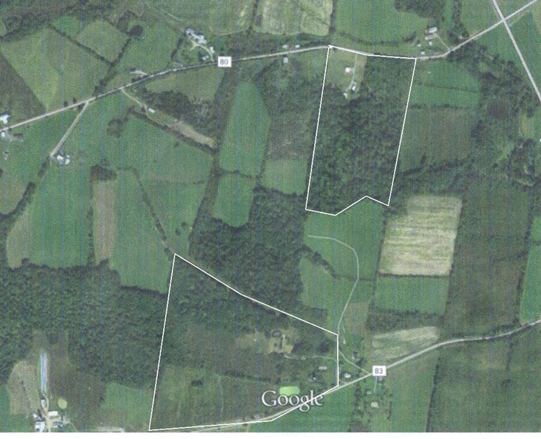
Non-contiguous parcels
Unique identifier for each Tree Farm
Unique location for each Tree Farm
May share a management plan
Notes:
Time: 1 Minute Materials: 2021 Eligibility Criteria & Guidance
A parcel is a single area of land with a defined boundary and ownership usually identified by local governments for the purposes of valuation or taxation. A Tree Farm may consist of one or many contiguous parcels. Include all contiguous parcels that contain the forested acres, or forest management unit, in a single Tree Farm.
If a right-of-way or break in ownership of 84-ft or greater separates the parcels, they should be designated as separate Tree Farms.

Slide 22
What’s new with the Tree Farm Eligibility Requirements?
  2015-2020
  Contiguity:
  A road under separate ownership , more than 84 feet wide, was defined as a break in contiguity.
  2021
Significant rights of way, under ownership of other entities, may* represent breaks in contiguous parcels. Significant rights of way are defined as at least 84 feet wide.
*Guidance: Non-contiguous parcels that lie under a single ownership and management unit, but are separated by a significant right of way, road, etc. and do not meet the >10 acres to be a stand-alone Tree Farm may be considered a part of the larger parcel for Tree Farm.
Notes:
Time: 1 Minute Materials: 2021 Eligibility Criteria & Guidance
The 2015-2020 resulted in small parcels being separated from larger ones…and if they were less than 10 acres, were then not a candidate for TF.

Slide 23
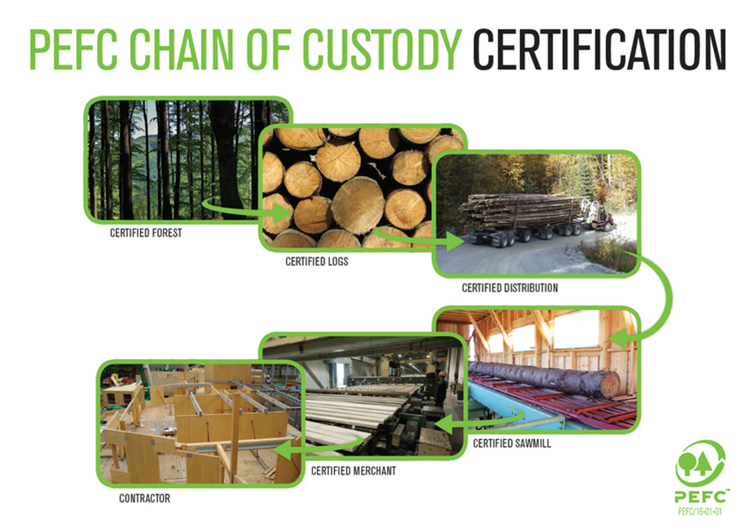
Notes:
Time: 1/2 minute
Materials: none
Because ATFS has PEFC endorsement, forest products can flow directly into the SFI chain. ATFS only certifies the management of the property, not the products coming off of it, so we do not provide our own CoC nor do we allow the Tree Farm logo on products.
In the certification process, PEFC sets benchmark standards for all national certification organizations to meet. PEFC endorses the AFF Standards of Sustainability as meeting their benchmark standards. Every year, AFF is audited by a certification body (currently NSF) to ensure we are abiding by our own standards. Conformance with the standards maintains our certificate for another year. A repeated nonconformity that cannot be adequately resolved could lead to the suspension and loss of AFF's national certificate. Inspectors must keep this in mind when certifying landowners and understand the repercussions of inaccurate or incomplete information.

Slide 24

What would you do?
A landowner has 2- 10 acre, non-contiguous parcels, and his house is on one.
A landowner has an interstate that separates his Tree Farm into 2 parts, with a separate access to each side.
A local sawmill wants to certify 5,000 acres of company land.
Notes:
Choose one or all of these scenarios to discuss as a large group OR in break out groups.
You may choose to update with actual events from your state program.

Slide 25
2021 Standards of Sustainability
Standards
Guidance
Glossary
Notes:
Time: 1 minute
Materials: 2021 Standards & Guidance
Go through the standards with the participants .
There are 4 main parts of the Standards.
The Standards Prologue provides the context for the 2021 AFF Standards. It details the purpose of the Standards, the audience, and an explanation of the structure.
The 8 Standards address the various areas of sustainable forestry as appropriate for family woodland owners.
There are a few terms in the new Standards that are commonly used in the conservation community, but family forest owners may not be so familiar with. We have defined them to make them more accessible to family forest owners. An example would be “Integrated Pest Management.” The glossary is an important document to provide a frame for the requirements within the standards.
The guidance document is a key resource for Inspectors and landowners, as it helps interpret how the standards are applied in the field.
Responsibility for conformance with the Standards lies with the landowner.

Slide 26

Standard Revision
Why review the ATFS Standards?
Incorporate Feedback and Learning from our Community
Comply with updated PEFC Requirements
Infuse emerging knowledge in forestry, landowner engagement, and technology
Broaden focus for conservation impact
Notes:
PEFC generally reviews their benchmark standards every five years. If changes to the benchmark standards are made, AFF must update the Standards of Sustainability to maintain our endorsement. The last major change to the benchmark standards was in 2019 which led to the current 2021 version of the AFF standards. Occasionally, the AFF Standards are updated between PEFC updates to reflect emerging knowledge in forestry or to improve clarity based on feedback from our community.

Slide 27
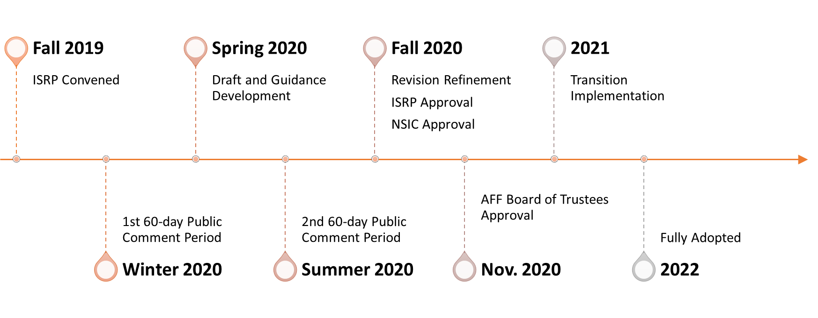
Standard Revision Process
Independent Standard Review Panel (ISRP)
  Appointed by the AFF Board of Trustees
  Facilitated by ATFS Certification Manager, Chair, and Independent Facilitator
Multiple in-person and online public comment and listening sessions
Review and Approval by the AFF Certification Committee
Review and Approval by the AFF Board of Trustees
In 2023, the PEFC Endorsement Process required more updates resulting in the release of AFF 2021 Standards version 2.0
Notes:
Time: 1 minute
Materials: 2021 Standards & Guidance
These Standards were developed at the direction of the AFF Board of Trustees by the AFF Independent Standards Review Panel (ISRP). The panel comprised a representative cross-section of forestry community leaders with a stake in the ATFS Certification Program or a sincere interest in forest sustainability in the United States. Members represented academia, the conservation community, the forest industry, landowners, foresters, loggers, buyers and public forest agencies. The work of the ISRP is guided by AFF’s Standard Setting Procedures and the Programme for Endorsement of Forest Certification (PEFC) requirements for standard setting of endorsed programs. They started with the existing 2015-2020 Standard, applied scientific developments within the field of forestry, solicited two rounds of comments and feedback from the public, and proposed them to the AFF Board, who accepted the changes.
The challenge is to develop an approach that:
-sets robust standards and realistic criteria for sustainable forest management that is accepted by stakeholders;
-continuously update them to incorporate new knowledge, best practices and changing expectations;
-is flexible enough to reflect specific circumstances, yet is also in compliance with international requirements; and
-is accessible, viable and affordable.
Sustainable forest management means the environmentally appropriate, socially beneficial, and economically viable management of forests for present and future generations. Sustainable forest management is an evolving process, and the parameters defining it change over time based on the latest scientific knowledge and society's understanding of the concept.
Forest certification gives consumers assurance that products they purchase originate from sustainably managed forests that protect economic, social and environmental benefits. PEFC endorsement of the Standard provides credibility throughout the world that our program meets or exceeds the agreed-up on benchmarks that comprise Sustainability.

Slide 28
What’s new with the standards?
  2015-2020 ATFS Standards
  Overall, you asked us to keep it simple and do not make any unnecessary changes.
  2021 ATFS Standards
  Landowners must document pesticide use
  Landowners must consult qualified natural resources professionals before afforesting ecologically important non-forest ecosystems.
Notes:
More detail on these changes will be covered as we go over the Standards individually.

Slide 29

Standard: overarching principle of sustainability.
Standard 1: Commitment to Practicing Sustainable Forestry
Landowner demonstrates commitment to forest health and sustainability by developing a forest management plan, implementing sustainable practices, and seeking opportunities to expand their knowledge and understanding of sustainable forest management.
Performance Measure 1.1
Landowner shall have and implement a written forest management plan consistent with the size of the forest and the scale and intensity of the forest activities.
Indicator 1.1.1
Management plan shall be active, adaptive, and embody the landowner’s current
objectives, remain appropriate for the land certified, and reflect the current state of
knowledge about natural resources and sustainable forest management.
Performance Measure: refines standard’s intent and describes considerations and pathways for conformance.
Standards Format
Underlined “shall”: core element required for ATFS certification.
Indicator: specific actions or activities that demonstrate conformance.
Bold type: Defined in the glossary.
Notes:
Simply stated certification boils down to:
What did you say you were going to do? (Standard)
Did you do it? (Performance measure)
Prove it. (Indicator)
If a word is bolded in the Standard, it means it is defined in the glossary.
If a shall is present, it signifies a required element of the Standard. If the Tree Farm does not conform to this element, it is grounds for decertification.
A Standard is the overarching principle of sustainability;
A Performance Measure refines the standard’s intent and describes considerations and pathways for conformance.
An Indicator identifies specific actions or activities that demonstrate conformance.

Slide 30

Standard 1:
Commitment to Practicing Sustainable Forestry
Landowner demonstrates commitment to forest health and sustainability by developing a forest management plan, implementing sustainable practices, and seeking opportunities to expand their knowledge and understanding of sustainable forest management.
Performance Measure 1.1
Landowner shall have and implement a written forest management plan consistent with the size of the forest and the scale and intensity of the forest activities.
Notes:
Time: 2 minutes
Materials: 2021 Standards & Guidance

Slide 31
What’s new with the standards?
  2015-2020 ATFS Standards
  Standard 1-
  Asked landowners for a commitment to sustainable forestry, but no specific mention of landowner education.
  2021 ATFS Standards
  Standard 1-
  Addition of landowner education
  Landowners are highly encouraged, but not required, to seek out education opportunities including workshops, field days, professionals, online resources, etc.
Notes:
We want LO’s to take their commitment to sustainable forestry serious by educating themselves to take a more active role in forest management.

Slide 32
Standard 1: Implementation
Commitment to Practicing Sustainable Forestry
Does the landowner have a plan consistent with the size of the forest and the scale and intensity of the forest activities?
Does the plan describe beginning conditions, objective(s), and a strategy for reaching those objectives?
Does the landowner monitor for change?
Does it contain all the required resource elements?
Notes:
Time: 2 minutes
Materials: 2021 Standards & Guidance
Reference 021 form

Slide 33

Standard 1: Implementation
Commitment to Practicing Sustainable Forestry
Management Plan Requirements:
Forest health
Soil
Water
Wood & fiber production
T&E species
Special sites
Invasive species
Forests of Recognized Importance (FORI)
Notes:
Time: 2 minutes
Materials: 2021 Standards & Guidance
Each of these required resource elements should be addressed in the management plan. If any are missing, they can be added in a variety of ways including: notes in the margin, an addendum, or the 021 Inspection Form. However the plan is updated, it is important to keep the update and plan together for reference.

Slide 34
Standard 1: Implementation
Commitment to Practicing Sustainable Forestry
Management Plan Additional Considerations:
Prescribed fire
Wetlands
Desired species
Recreation
Aesthetics
Biomass
Carbon
Notes:
Time: 2 minutes
Materials: 2021 Standards & Guidance
These resource elements may not apply to every Tree Farm so they are not required in every plan. However, it they do occur on the property, they must be addressed in the plan.

Slide 35
Standard 1: Implementation
Commitment to Practicing Sustainable Forestry
Management Plan Addendum
Notes:
Time: 2 minutes
Materials: 2021 Standards Addendum

Slide 36
Standard 1:
Commitment to Practicing Sustainable Forestry
Recent Assessment Findings:
Eligibility Requirements
  Acreage discrepancies between plan and database.
  Contiguity
Management Plan missing elements
  FORI
  Soils
  Map
  A description of potential T&E species but no statement if any are present.
Notes:
Time: 2 minutes
Materials: 2021 Standards & Guidance
These are areas where Non-conformance or Opportunity for Improvement findings are common during a third-party assessment.
Encourage foresters to pay close attention to how these are addressed in the management plan and recorded on the inspection form. Remember that the 021 Inspection Form can serve as a plan update. It covers all of the required aspects of certification, but the landowner must possess a copy.

Slide 37
What would you do?
A landowner’s plan was written in 1996.
A landowner has 5 non-contiguous parcels that are all covered in 1 management plan.
A landowner is using an addendum that was completed in 2015.
Notes:
Choose one or all of these scenarios to discuss as a large group OR in break out groups.
You may choose to update with actual events from your state program.

Slide 38

Standard 2:
Compliance with Laws
Forest management activities comply with all relevant federal, state and local laws, regulations and ordinances.
Performance Measure 2.1
Landowner shall comply with all relevant federal, state, county and municipal laws, regulations and ordinances governing forest management activities.
Notes:
Time: 2 minutes
Materials: 2021 Standards & Guidance

Slide 39
Standard 2:
Compliance with Laws
Insert State BMP’s, regulations, ordinances, guidelines, etc…
Including where to find more information
Notes:
Time: 2 minutes
Materials: 2021 Standards & Guidance

Slide 40
Standard 2: Implementation
Compliance with laws
Does the landowner seek advice on relevant laws, regulations, and ordinances?
  Appropriate resources include:
    Qualified Natural Resource Professionals
    Qualified Contractors
    Location specific (city, county, state, federal)
Does the landowner comply with all laws, regulations, and ordinances?
Notes:
Time: 2 minutes
Materials: 2021 Standards & Guidance
Reference 021 form

Slide 41
Standard 2:
Compliance with Laws
Recent Assessment Findings
Insufficient resources consulted/recorded to determine the presence/absence of Federal/State/local laws and ordinances.
Notes:
Time: 2 minutes
Materials: 2021 Standards & Guidance
These are areas where Non-conformance or Opportunity for Improvement findings are common during a third-party assessment.
Encourage foresters to pay close attention to how these are addressed in the management plan and recorded on the inspection form. An Overview of Applicable Laws and Regulations is provided in Appendix A of the AFF Standards of Sustainability, v2.2.

Slide 42
What would you do?
A landowner refuses to allow a state agency water quality forester to inspect a recent harvest operation’s creek crossing.
A landowner discovers a gopher tortoise burrow in a food plot.
Notes:
Choose one or all of these scenarios to discuss as a large group OR in break out groups.
You may choose to update with actual events from your state program.
Reference state specific laws and regulations here.

Slide 43

Standard 3:
Reforestation and Afforestation
Landowner completes timely restocking of desired species of trees on a regeneration harvest site and non-stocked areas where tree growing is consistent with land use practices and the landowner’s objectives.
Performance Measure 3.1
Reforestation or afforestation shall be achieved by a suitable process that ensures adequate stocking levels.
Notes:
Time: 2 minutes
Materials: 2021 Standards & Guidance

Slide 44
Standard 3:
Reforestation and Afforestation
Indicator 3.1.2
Landowners shall consult with a qualified resource professional to ensure that proposed afforestation does not have a negative ecological impact or degrade ecologically important non-forest ecosystems*. Afforestation shall not occur if the evaluation determines that a negative impact or degradation is likely.
* Examples: wetlands, native grasslands, peatlands, shrublands, etc.

Slide 45
What’s new with the standards?
  2015-2020 ATFS Standards
  Standard 3-
  Offered no guidance to landowners on reforestation resulting in conversion to plantation OR in afforestation of non-forest ecosystems.
  2021 ATFS Standards
  Standard 3- G for I 3.1.1
  Addition of ‘conversion’ guidance:
  A plantation may be established to add economic or ecosystem value.
Notes:
This addressed a gap we had with the PEFC meta-standard.

Slide 46
What’s new with the standards?
  2015-2020 ATFS Standards
  Standard 3-
  Landowners were encouraged to use native species for reforestation and afforestation.
  Current and potential use of genetically modified trees was unclear.
  2021 ATFS Standards
  Standard 3- G for I 3.1.1
  Addition of ‘naturalized species.’
  Addition of guidance that prohibits the use of genetically modified trees.
  Current stock offered by ACF is NOT considered GMO per PEFC.
  ATFS commits to follow the emerging science and revisit as needed.
Notes:
This was an addition per PEFC.
This rule pertains to genetically modified trees ONLY and does not apply to GMO use in grasses or understory.

Slide 47
What’s new with the standards?
  2015-2020 ATFS Standards
  Standard 3-
  Requirement to consult a natural resource proffessional prior to reforesting or afforesting an ecologically important non-forest ecosystem.
  2021 ATFS Standards
  Indicator 3.1.2:
  Afforestation will not occur if there are negative impacts on an ecologically important non-forest ecosystem.
  (This situation in the United States is uneconomical and therefore rare.)
Notes:
This is a very rare situation in the US because afforesting an ecologically important non-forested ecosystem is generally non-forested because it will not support trees.

Slide 48
Standard 3: Implementation
Afforestation and Reforestation
Has the property been reforested, harvested, or afforested in the past 5 years?
Is so, were the desired outcomes achieved by suitable process?
How was this achieved?
  Natural regeneration, hand or machine planted, etc….
Notes:
Time: 2 minutes
Materials: 2021 Standards & Guidance
Reference 021 form

Slide 49
Standard 3:
Reforestation and Afforestation
Recent Assessment Findings:
Monitoring reforestation/afforestation for stocking/survival.
Potential future finding: No documentation showing consultation with a natural resource professional prior to afforestation.
Notes:
Time: 2 minutes
Materials: 2021 Standards & Guidance
These are areas where Non-conformance or Opportunity for Improvement findings are common during a third-party assessment.
Encourage foresters to pay close attention to how these are addressed in the management plan and recorded on the inspection form.

Slide 50
What would you do?
An entire Tree Farm was clearcut in 2015 and replanted.
A landowner converted old pasture land to a loblolly plantation.
A landowner is looking to plant a genetically improved seedling stock.
Notes:
Choose one or all of these scenarios to discuss as a large group OR in break out groups.
You may choose to update with actual events from your state program.
Reference state specific resources.

Slide 51

Standard 4:
Air, Water, and Soil Protection
Forest management practices maintain or enhance the ecosystems and ecosystem services provided by the forest, including air, water, soil and site quality.In addition, landowners are encouraged to consider climate-positive practices.
Performance Measure 4.1
Landowner shall meet or exceed practices prescribed by state forestry best management practices (BMPs) that are applicable to the property.
Notes:
Time: 2 minutes
Materials: 2021 Standards & Guidance

Slide 52
Standard 4:
Air, Water, and Soil Protection
Insert all applicable state BMP’s
Including, but not limited to:
Timber Harvesting
Water Quality
Etc…
Notes:
Time: 2 minutes
Materials: 2021 Standards & Guidance

Slide 53
Standard 4: Implementation
Air, Water, and Soil Protection
Does the landowner know and meet the applicable state forestry best management practices (BMP’s)?
Are water features present on the property?
What steps are taken to minimize soil disturbance?
Notes:
Time: 2 minutes
Materials: 2021 Standards & Guidance
Reference 021 form

Slide 54

Standard 4:
Air, Water, and Soil Protection
Forest management practices maintain or enhance the ecosystems and ecosystem services provided by the forest, including air, water, soil and site quality.
Performance Measure 4.2
Landowner shall consider a range of forest management activities to control pests, pathogens and unwanted vegetation
Notes:
Time: 2 minutes
Materials: 2021 Standards & Guidance

Slide 55
What’s new with the standards?
  2015-2020 ATFS Standards
  Standard 4-
  No requirement for landowner to maintain pesticide usage, outside laws and regulation requirements.
  2021 ATFS Standards
  Standard 4- G for I 4.2.2
  Additional requirement to maintain records of all pesticide usage.
  What kind of records?
  Application, storage, disposal, qualified applicator
Notes:
This addition to the standard was a PEFC requirement.
Documentation is required to show that the pesticide is approved by the EPA and applied, stored and disposed of in accordance with EPA-approved labels and by persons appropriately trained, licensed and supervised.

Slide 56
Standard 4: Implementation
Air, Water, and Soil Protection
Does the landowner consider a range of activities to control forest pests, pathogens, and unwanted vegetation?
Are pesticides used, and if so, is the use documented?
Notes:
Time: 2 minutes
Materials: 2021 Standards & Guidance
Reference 021 form

Slide 57

Standard 4:
Air, Water, and Soil Protection
Forest management practices maintain or enhance the ecosystems and ecosystem services provided by the forest, including air, water, soil and site quality.
Performance Measure 4.3
When used, prescribed burns shall conform with landowner’s objectives and all applicable rules, laws, and regulations.
Notes:
Time: 2 minutes
Materials: 2021 Standards & Guidance

Slide 58
Standard 4: Implementation
Air, Water, and Soil Protection
Is prescribed fire used on the property, and if so, are all state and local laws and regulations followed?
What is the objective of using prescribed fire?
Notes:
Time: 2 minutes
Materials: 2021 Standards & Guidance
Reference 021 form

Slide 59
Standard 4:
Air, Water, and Soil Protection
Recent Assessment Findings:
BMP
  Awareness by landowner
    What are the state BMP’s and where can they find them?
  Implementation
    Stream crossing
    Culvert installation
    Etc…
Documentation
  Chemical use documentation
  Permits (burn/stream crossing/etc.)
Notes:
Time: 2 minutes
Materials: 2021 Standards & Guidance
These are areas where Non-conformance or Opportunity for Improvement findings are common during a third-party assessment.
Encourage foresters to pay close attention to how these are addressed in the management plan and recorded on the inspection form.

Slide 60
What would you do?
A landowner recently had a prescribed burn on their property.
The landowner is not keeping a record of recent herbicide application to control patches of kudzu on the property.
The landowner doesn’t know what the state BMP’s are, or if he needs a permit for harvest.
Notes:
Choose one or all of these scenarios to discuss as a large group OR in break out groups.
You may choose to update with actual events from your state program.
Reference state specific resources.

Slide 61

Standard 5:
Fish, Wildlife, Biodiversity & Forest Health
Forest management activities contribute to the conservation of biodiversity.
Performance Measure 5.1
Forest management activities shall protect habitats and communities occupied by threatened or endangered species as required by law.
Notes:
Time: 2 minutes
Materials: 2021 Standards & Guidance

Slide 62
Standard 5:
Fish, Wildlife, Biodiversity & Forest Health
Insert state specific information here for T&E species, including:
Websites or other resources a landowner or forester may consult to determine the presence/absence of T&E species
Notes:
Time: 2 minutes
Materials: 2021 Standards & Guidance

Slide 63
Standard 5: Implementation
Fish, Wildlife, Biodiversity & Forest Health
Are threatened/endangered species on the property?
What resources were consulted to determine the presence/absence of threatened and endangered species?
When were they last referenced?
Appropriate resources include:
    Qualified Natural Resource Professional
    US Fish and Wildlife Service
    State agency
Notes:
Time: 2 minutes
Materials: 2021 Standards & Guidance
Reference 021 form

Slide 64

Standard 5:
Fish, Wildlife, Biodiversity & Forest Health
Forest management activities contribute to the conservation of biodiversity.
Performance Measure 5.2
Landowner should address the desired species and/or desired forest communities when conducting forest management activities, if consistent with landowner’s objectives.
Notes:
Time: 2 minutes
Materials: 2021 Standards & Guidance

Slide 65
Standard 5: Implementation
Fish, Wildlife, Biodiversity & Forest Health
Has the landowner identified objectives related to desired species and/or forest communities?
If so, which species/forest community?
What actions is the landowner taking towards this effort?
Notes:
Time: 2 minutes
Materials: 2021 Standards & Guidance
Reference 021 form

Slide 66

Standard 5:
Fish, Wildlife, Biodiversity & Forest Health
Forest management activities contribute to the conservation of biodiversity.
Performance Measure 5.3
Landowner should make practical efforts to promote forest health.
Notes:
Time: 2 minutes
Materials: 2021 Standards & Guidance

Slide 67
Standard 5: Implementation
Fish, Wildlife, Biodiversity & Forest Health
What actions does the landowner take to monitor and promote forest health?
Which forest health issues are relevant to the property?
Notes:
Time: 2 minutes
Materials: 2021 Standards & Guidance
Reference 021 form

Slide 68

Standard 5:
Fish, Wildlife, Biodiversity & Forest Health
Forest management activities contribute to the conservation of biodiversity.
Performance Measure 5.4
Where present, forest management activities should maintain or enhance forests of recognized importance.
Notes:
Time: 2 minutes
Materials: 2021 Standards & Guidance

Slide 69
Standard 5:
Fish, Wildlife, Biodiversity & Forest Health
List state resources for determining presence/absence FORI.
If no FORI are designated for your state, address that here as well.
Notes:
Time: 2 minutes
Materials: 2021 Standards & Guidance

Slide 70
Standard 5: Implementation
Fish, Wildlife, Biodiversity & Forest Health
What resources were consulted to determine if FORI are present on the property?
Is FORI relevant to this property?
If FORI so, what activities should a landowner consider to enhance or maintain FORI?
Notes:
Time: 2 minutes
Materials: 2021 Standards & Guidance
Reference 021 form
Make sure inspectors know where to find the current definition of FORI for their state.

Slide 71
Standard 5:
Fish, Wildlife, Biodiversity & Forest Health
Recent Assessment Findings:
Insufficient research and documentation of resources consulted for:
T&E Species
  Descriptions and resources provided, but no statement of presence on the property.
Invasive Species
FORI
Notes:
Time: 2 minutes
Materials: 2021 Standards & Guidance
These are areas where Non-conformance or Opportunity for Improvement findings are common during a third-party assessment.
Encourage foresters to pay close attention to how these are addressed in the management plan and recorded on the inspection form.

Slide 72
What would you do?
A landowner ‘knows’ they don’t have any T&E species on the property.
There are no state specified FORI for your state, but a Tree Farm is located on a major bay.
A landowner wishes to manage their property for white oak only, and wishes to eradicate other hardwood species.
Notes:
Choose one or all of these scenarios to discuss as a large group OR in break out groups.
You may choose to update with actual events from your state program.
Reference state specific resources.

Slide 73

Standard 6:
Forest Aesthetics
Forest management activities recognize the value of forest aesthetics.
Performance Measure 6.1
Landowner should manage the visual impacts of forest management activities consistent with landowner objectives, the size of the forest, the scale and intensity of forest management activities and the location of the property.
Notes:
Time: 2 minutes
Materials: 2021 Standards & Guidance

Slide 74
Standard 6: Implementation
Forest Aesthetics
Does the landowner consider the visual impacts of forest management?
If so, what steps does the landowner take in their forest management activities?
Notes:
Time: 2 minutes
Materials: 2021 Standards & Guidance
Reference 021 form

Slide 75
Standard 6:
Forest Aesthetics
Recent Assessment Findings:
No recent findings regarding Forest Aesthetics.
Notes:
Time: 2 minutes
Materials: 2021 Standards & Guidance
These are areas where Non-conformance or Opportunity for Improvement findings are common during a third-party assessment.
Encourage foresters to pay close attention to how these are addressed in the management plan and recorded on the inspection form.

Slide 76
What would you do?
A landowner is clearcutting a section of forest located close to road, and does not want to leave a visual ‘buffer strip’ of uncut forest.
Notes:
Choose one or all of these scenarios to discuss as a large group OR in break out groups.
You may choose to update with actual events from your state program.
Reference state specific resources.

Slide 77

Standard 7:
Special Sites
Special sites are managed in ways that recognize their unique historical, archeological, cultural, geological, biological or ecological characteristics.
Performance Measure 7.1
Forest management activities shall consider and maintain any special sites relevant on the property.
Notes:
Time: 2 minutes
Materials: 2021 Standards & Guidance

Slide 78

Standard 7:
Special Sites
What is a Special Site?
Historical
Archeological
Cultural
Geological
Biological
Ecological
Landowner designated site
Notes:
Time: 2 minutes
Materials: 2021 Standards & Guidance

Slide 79
Standard 7: Implementation
Special Sites
What resources does the landowner consult to determine if there are special sites on the property?
Are special sites on the property?
If so, how are they being protected?
Notes:
Time: 2 minutes
Materials: 2021 Standards & Guidance
Reference 021 form

Slide 80
Standard 7:
Special Sites
Recent Assessment Findings
Insufficient research and documentation for resources consulted to determine presence/absence of Special Sites.
Special Sites found on the ground, but not noted in the management plan or marked on the map.
Notes:
Time: 2 minutes
Materials: 2021 Standards & Guidance
These are areas where Non-conformance or Opportunity for Improvement findings are common during a third-party assessment.
Encourage foresters to pay close attention to how these are addressed in the management plan and recorded on the inspection form.

Slide 81
What would you do?
A landowner does not plan to do any forest management activity within 100 feet of his cabin site.
A landowner marks a well kept family cemetery on the ground, but does not mention it in the plan, nor is it marked on the map.
Notes:
Choose one or all of these scenarios to discuss as a large group OR in break out groups.
You may choose to update with actual events from your state program.
Reference state specific resources.

Slide 82

Standard 8:
Forest Products Harvest and Other Activities
Forest product harvests and other management activities are conducted in accordance with the landowner’s objectives and consider other forest values.
Performance Measure 8.1
Landowner should use qualified natural resource professionals and qualified contractors when contracting for services.
Notes:
Time: 2 minutes
Materials: 2021 Standards & Guidance

Slide 83
Standard 8:
Forest Products Harvest and Other Activities
Forest product harvests and other management activities are conducted in accordance with the landowner’s objectives and consider other forest values.
Performance Measure 8.2
Landowner or designated representative shall monitor forest product harvests and other management activities to ensure they conform to their objectives.
Notes:
Time: 2 minutes
Materials: 2021 Standards & Guidance

Slide 84
Standard 8: Implementation
Forest Products Harvest and Other Activities
Does the landowner seek out and use qualified natural resource professionals and qualified contractors?
How do they determine if the contractors are following all appropriate rules and laws?
Do they retain copies of contracts?
Does the landowner or designated representative monitor forest management activities?
Notes:
Time: 2 minutes
Materials: 2021 Standards & Guidance
Reference 021 form

Slide 85
Standard 8:
Forest Products Harvest and Other Activities
Recent Assessment Findings:
Use of contracts
Insufficient monitoring of forest management activities which lead to negative impacts on the ground
Notes:
Time: 2 minutes
Materials: 2021 Standards & Guidance
These are areas where Non-conformance or Opportunity for Improvement findings are common during a third-party assessment.
Encourage foresters to pay close attention to how these are addressed in the management plan and recorded on the inspection form.

Slide 86
What would you do?
A landowner lives 100 miles from their Tree Farm. They agree to let their neighbor cut down a few trees for firewood, but now they notice 2 acres of forest have been completely cleared.
A landowner had a contract for a recent thinning, but now doesn’t know where a copy of the contract is.
Notes:
Choose one or all of these scenarios to discuss as a large group OR in break out groups.
You may choose to update with actual events from your state program.
Reference state specific resources.

Slide 87
Inspections

Slide 88
Two levels of Certification
Internal Monitoring
Inspections
Trained inspectors verify landowner conformance.
External Monitoring
Third Party Certification
Accredited Certification Body performs a third-party assessment.
Notes:
Internal Monitoring
Tree Farm has two levels of certification. The process that inspectors are directly involved with is considered internal monitoring of the program.
Inspectors work with State Tree Farm Committees to bring new landowners into the program and keep track of those already certified. These are the inspections we have already talked about – initial inspections, required sample inspections, optional re-inspections.
Third-party assessments will look closely at required sample inspections, so it is absolutely essential these are completed in the year they are assigned.
Third-Party Certification
Third-party certification for the state committees happens at the regional level. Tree Farmers enrolled through state committees by inspectors are considered officially certified under the AFF national certificate.
An accredited certification body (currently NSF) conducts annual assessments on the ATFS program in a handful of certified states with all certified states visited at some point in a 5-year certification cycle.
Inspectors may be asked to assist with third party certification assessments in their state if a landowner who they work with is selected as part of a field visit. If this is the case, then the inspector’s role will vary depending on how involved the landowner is. Inspectors may be asked to gather management plans and other documentation and potentially meet with the third-party assessor on site.
Group certification programs undergo their own third-party assessments separate from the state program process.
Tree Farmer proof of certification
Tree Farmers have a unique Tree Farm number for the purpose of our internal monitoring system and the regional certificate. The certificate number is the same for every Tree Farm. Manufacturing companies use both Tree Farm numbers and the certificate number as part of their chain of custody tracking for ATFS certified wood. Group members are under a separate certificate and will have a number that corresponds to their group program.

Slide 89
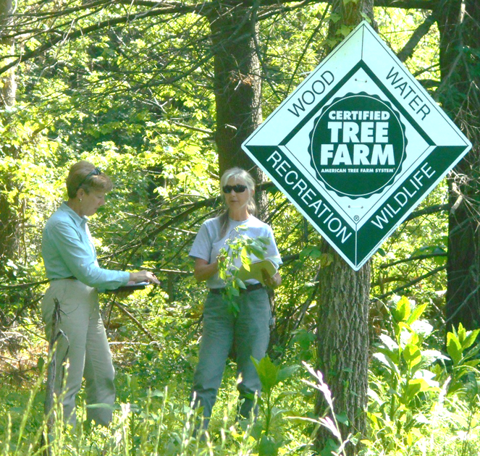
What is the purpose of inspections?
Connect with landowners
Help landowners determine their management objectives and goals
Assess if the landowners are conforming to the Standards
Ensure credibility of ATFS Certification
Notes:
Time: 1 minute
Materials: none
Inspections are an important point of contact for Tree Farmers. Inspectors have the very important role in ensuring conformance to the AFF Standards and eligibility for the Tree Farm program. Once inspected, landowners may not be visited for several years.
Inspections are the basis of our internal monitoring process, and ensuring high quality information is gathered during inspections enables ATFS to maintain its credibility as the largest forest certification program for non-industrial private forest owners. Inspectors must approach each inspection with the perspective of an auditor to ensure all aspects of the Standards are being complied with.

Slide 90

Tree Farm Inspections
Protocol
Review Eligibility for Tree Farm participation
Review ATFS Standard
Inspect Management Plan
Inspect Property
Notes:
Time: 1 minute
Materials: none
There are four important components to any type of inspection. These will each be elaborated upon on the next 4 slides. All types of inspections should follow this protocol.
The requirements include the eligibility, landowner requirements and property requirements.

Slide 91
Tree Farm Inspections
Review Eligibility for Tree Farm participation
  Is the acreage correct and eligible?
  What is the ownership type?
  Is the landowner willing to adhere to the standards and participate in assessments?
Notes:
Time: 1 minute
Materials: none
Is the Landowner and property eligible for participation? Do they meet the Eligibility criteria?
Example Questions that an inspector could ask:
Does the landowner meet the ATFS eligibility requirements?
Is the landowner willing to participate in a third-party certification assessment?
During the inspection, the inspector should review the Tree Farm program requirements with the landowner.
If they do not meet the requirements but would like to continue in the program, Pioneer is a great option to enable them to remain engaged in the program and access the tools available to landowners. However, these landowners are committed to building their stewardship and reaching full compliance within three years. Pioneer may serve as an introductory level of participation in the program, but it is not a mandatory starting point for Tree Farmers meeting all requirements of ATFS Certification.
Landowners meeting the AFF Standard should be considered for ATFS Certification.

Slide 92
Tree Farm Inspections
Review ATFS Standard
  Does the landowner meet the standards?
  Do they record activities that support Certification or Recognition?
Notes:
Time: 1 minute
Materials: none
New Tree Farmers can review the current program policies and standards on the Tree Farm website.
Inspectors may direct Tree Farmers to the appropriate State Tree Farm Committee contact, or ATFS National Staff for Standards information.

Slide 93
Tree Farm Inspections
3. Inspect Management Plan
  All core elements addressed?
  Additional considerations addressed if appropriate?
  Schedule of activities still applicable?
  Addendum or updates?
Notes:
Time: 1 minute
Materials: none
Even if the Standard does not apply, the Standard must be addressed. Be sure to document all consultations made.
The Management Plan Addendum and the 021 Inspection form provide a framework for addressing these standards.

Slide 94
Tree Farm Inspections
3. Inspect Management Plan
When should a management plan be updated?
  Changes to landowner objectives or management strategy (not activity schedule).
  Changes to owners, ownership or acres
Notes:
Time: 1 minute
Materials: none
Rule of Thumb: if the forest management plan no longer reflects the objectives or management strategy, then it is time to update.
Always verify that each element of the plan is still valid and relevant. If it is isn't, update the 021 form and use the Addendum for other quick updates.
Substantial updates require updates to the plan itself.
Plan updates can be made in a variety of ways: a full rewrite, handwritten notes in the margin, and addendum, even the 021 Inspection Form may be used to add additional or updated information provided a copy is kept with the plan. Inspectors are encouraged to always provide a copy of approved inspection form to the landowner.

Slide 95
Tree Farm Inspections
Inspect Property
  Recent management
  Unique features
  Ground truth the map
  Areas of emphasis
  Landowner questions
  Document findings
Notes:
Time: 1 minute
Materials: none
Be sure that the map includes all land property features. Ensure that the property acreage is consistent with the maps and ATFS Database acreage.
This is an opportunity to ask the landowners about any management questions they have on the property.
Filling out the 021 form – The 021 form provides a guide for what to examine during an inspection, we will be reviewing the form in upcoming slides.
One of the important benefits of the Tree Farm program for landowners is the management recommendations given to them by the professional forester inspector. There is a specific place on the 021 form for management recommendations.

Slide 96
Inspection Protocol
Initial Inspection
Requires Field Visit
Full review of management plan and supporting documents, including:
  Map
  Schedule of activities
  Contracts
  Other supporting documents
Notes:
Time: 1 minute
Materials: Tree Farm Inspection

Slide 97
Inspection Protocol
Required Inspection
Requires field visit if management activity has occurred on the ground since the last inspection OR if the previous inspection occurred >3 years.
If a field visit is not required, the remote ‘desk’ audit would include:
  Full review of the management plan documents, including maps, management activity schedule, and other supporting documents.
  Current aerial/satellite imagery, remote sensing, or other emerging technologies support of records.
Notes:
Time: 1 minute
Materials: none

Slide 98
Inspection Protocol
Monitoring Inspection
Requires a field visit if management activity has occurred on the ground since the last inspection.
If a field visit is not required, the remote ‘desk’ audit would include:
  Full review of the management plan documents, including maps, management activity schedule, and other supporting documents.
  Current aerial/satellite imagery, remote sensing, or other emerging technologies support of records.
Notes:
Time: 1 minute

Slide 99
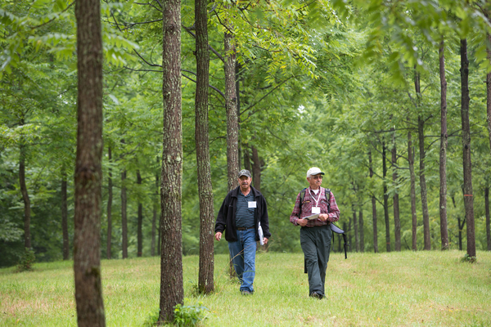
Tree Farm Inspections
Recommendation Options:
Certification/Recognition
Pioneer
Decertification
Notes:
Time: 1 minute
Materials: none
There are three outcomes following an inspection.
If the management and management plan meet the AFF Standards of Sustainability and the landowner is eligible for participation in the Tree Farm program, the property can be recommended for certification.
If you find that the management or management plan do not meet the Standards, but the landowner is committed to stewardship, you may recommend the property as a Pioneer Tree Farm. Pioneer Tree Farms are not considered certified but are included in the program so that the landowner benefits from education and outreach provided by the state committee.
If the management or the management plan do not meet the Standards, and the landowner is not willing to change either to bring them into conformance, the property should not be certified through ATFS. For the required sample inspection and optional inspections, the landowner should be de-certified.

Slide 100
ATFS Tree Farm Inspection Record
021 Form

Slide 101
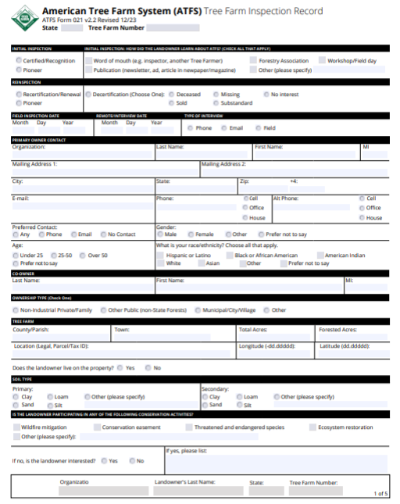

021 Form
Key to Certification under ATFS
Recently revised for the new 2021 standards
All inspections must be done with this form starting 3/15/2021
You must be trained to the 2021 Standards to use this form

Slide 102
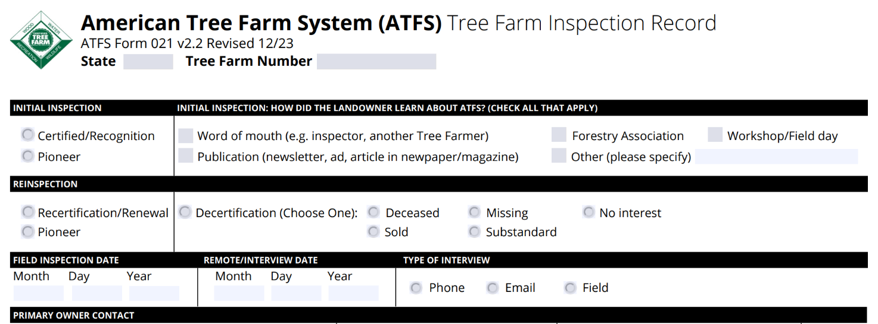

Latest version released in December of 2023.
This date should be entered as the date the landowner visit occurred- field or remote.

Slide 103
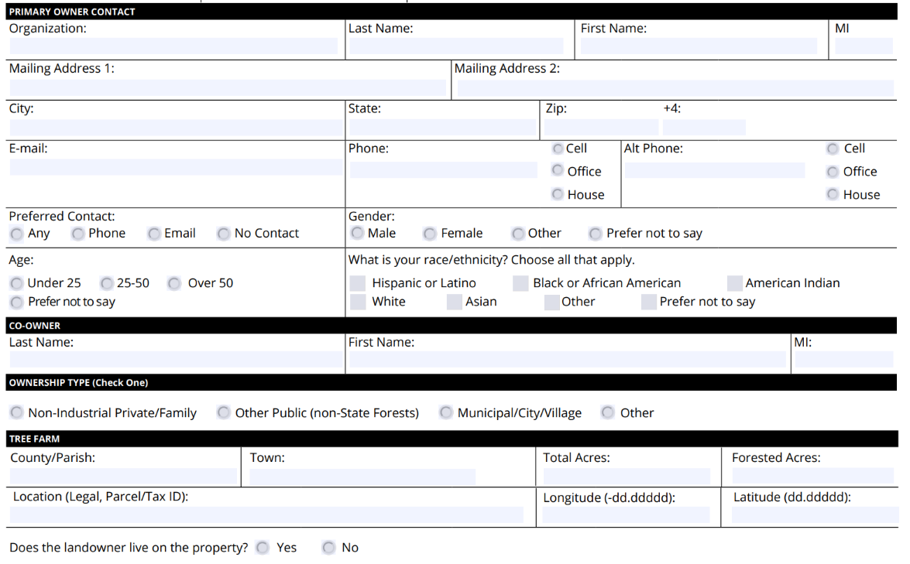

Notes:
Latitude and Longitude fields have been added to version 2.2 of the 021 form under the Tree Farm section. Though not required, this data is highly recommended. Please used decimal degrees, not degrees, minutes, seconds. The exact location of the point may be the main entrance, center of the property, or anywhere else that will show the general location of the property on a county-level map.

Slide 104
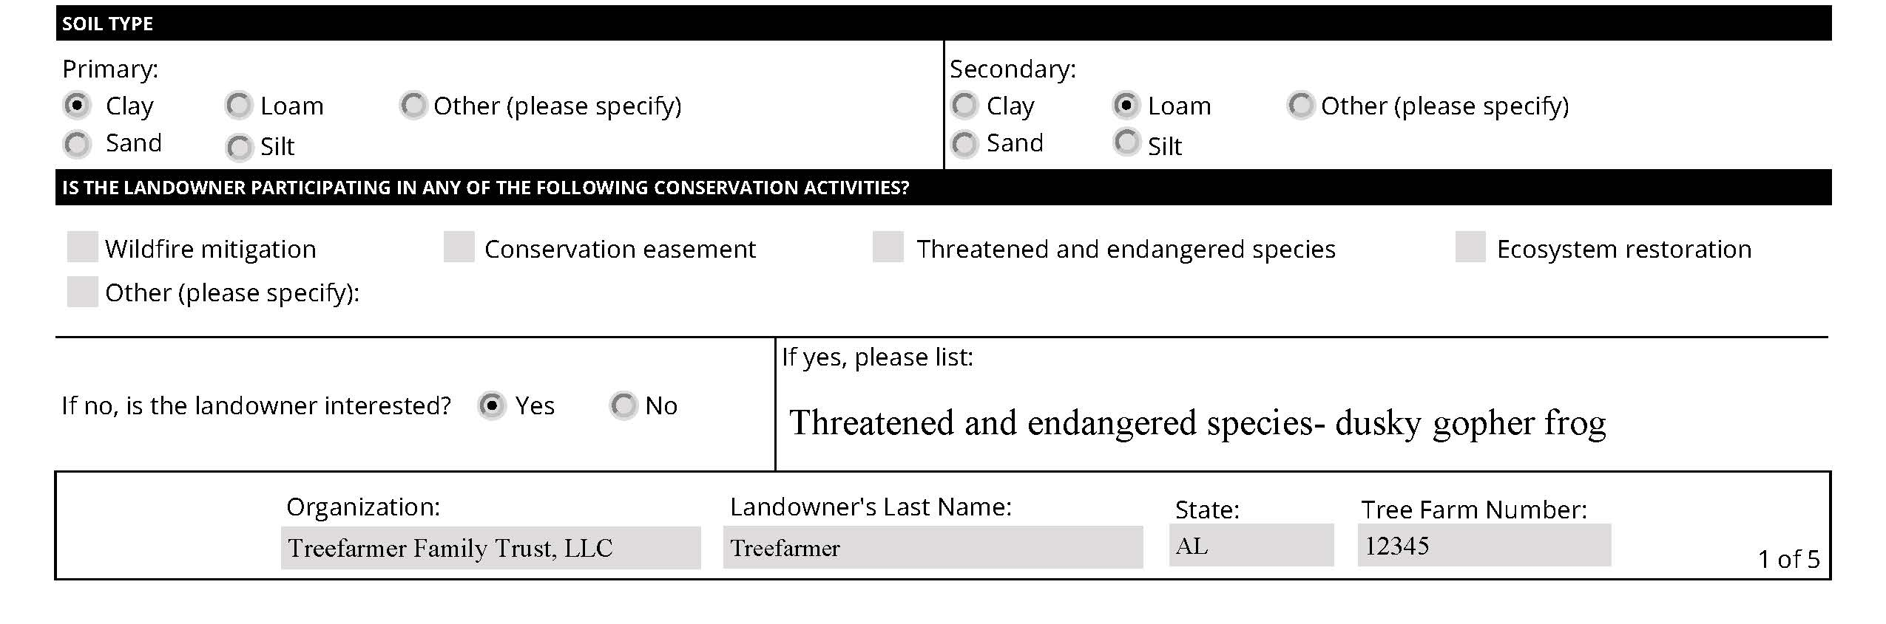

Slide 105
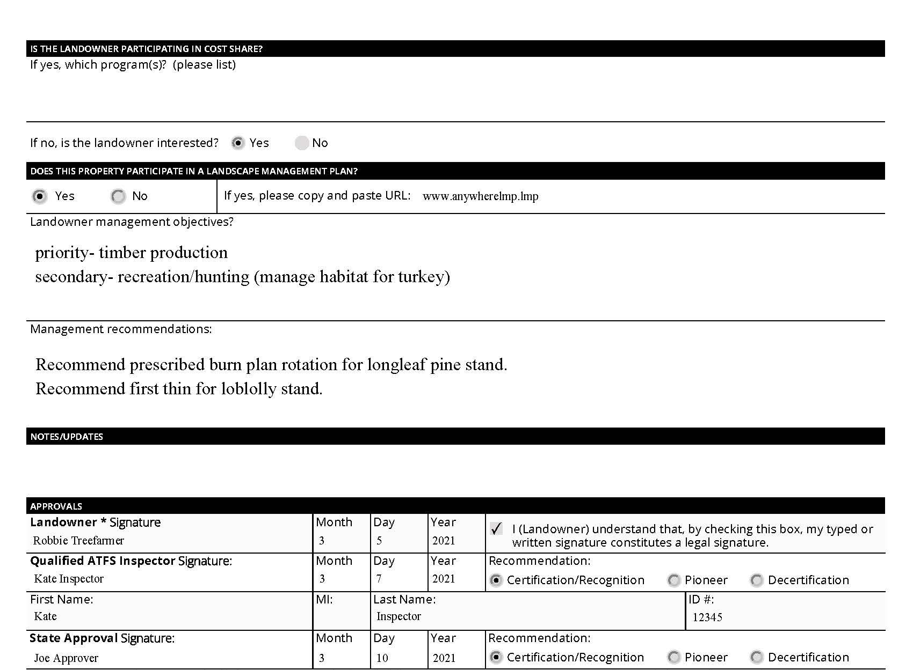
Notes:
Though only required for properties that use the Landscape Management Plan (LMP), inspectors are encouraged to enter a summary of the landowner objectives and management recommendations. This information is useful when using the 021 form as a plan summary or update.

Slide 106
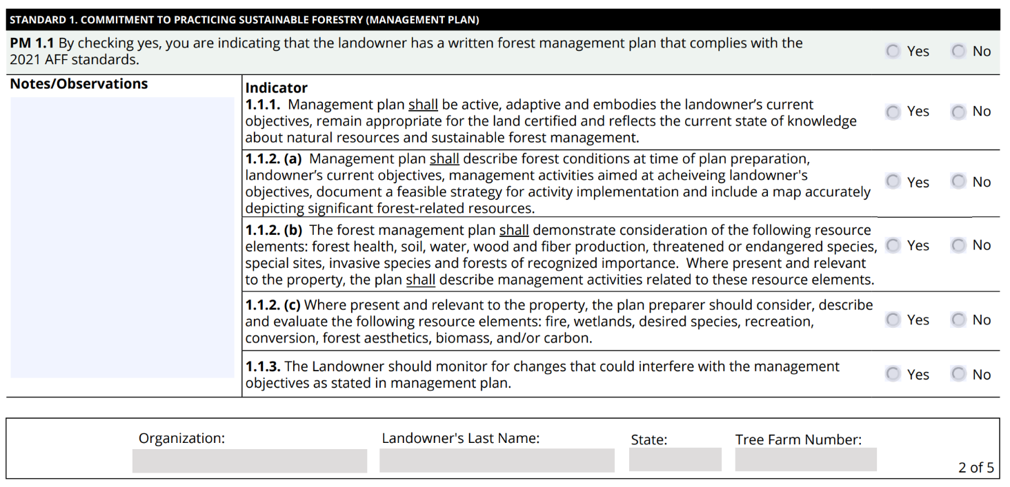
Notes:
Recent editorial change to Ind. 1.1.2 clarifying its intent. The plan should describe beginning conditions, objectives (desired future condition), and a strategy to achieve the objectives. Indicator 1.1.3 discusses monitoring the property. Landowners are encouraged to update the plan as needed based on that monitoring.
Adding additional information in the Notes section is always a good idea.

Slide 107
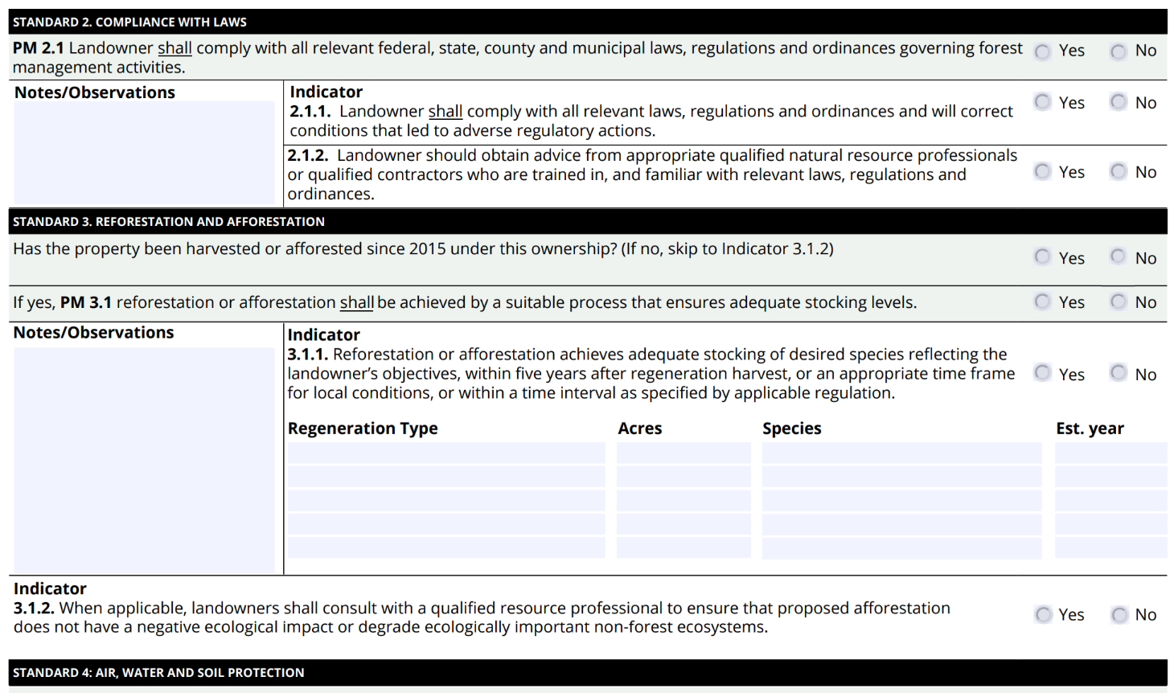
Notes:
Indicator 3.1.2 was added to version 2.2 of the Standards and the 021 Inspection Form.

Slide 108
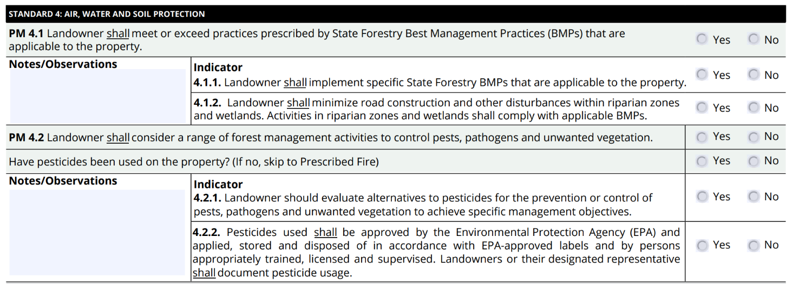

Slide 109
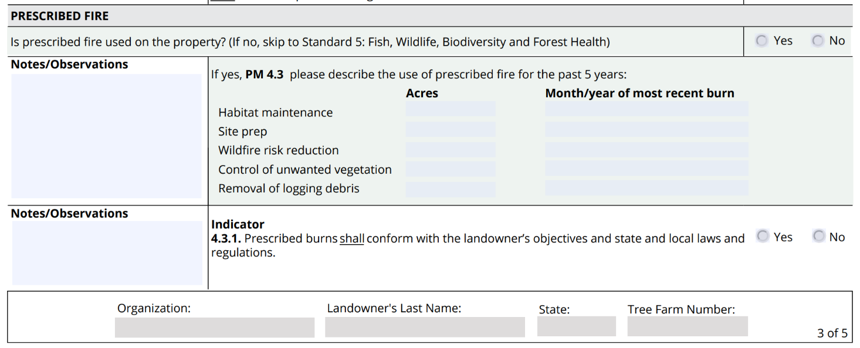

Slide 110
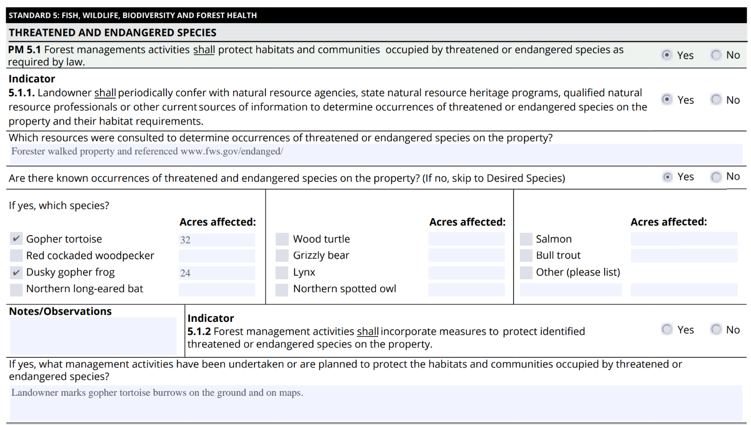
It is important to list a documented source of information here.
Notes:
Always list a DOCUMENTED SOURCE of information consulted to determine the presence or absence of threatened and endangered species.​
IF A SPECIES IS NOT PRESENT- SKIP FORWARD​
IF A SPECIES IS PRESENT- Use ‘new’ chart to indicate which species are found. If not listed, use OTHER box to note which species

Slide 111
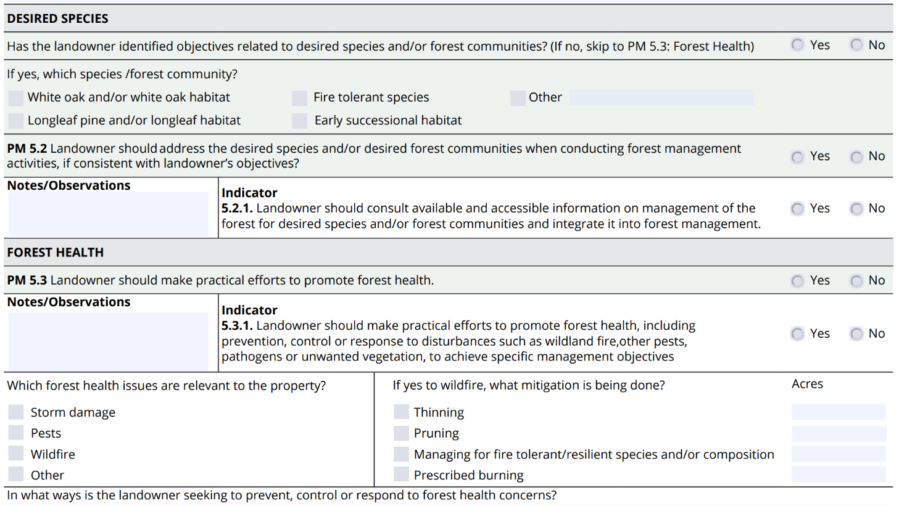

Slide 112
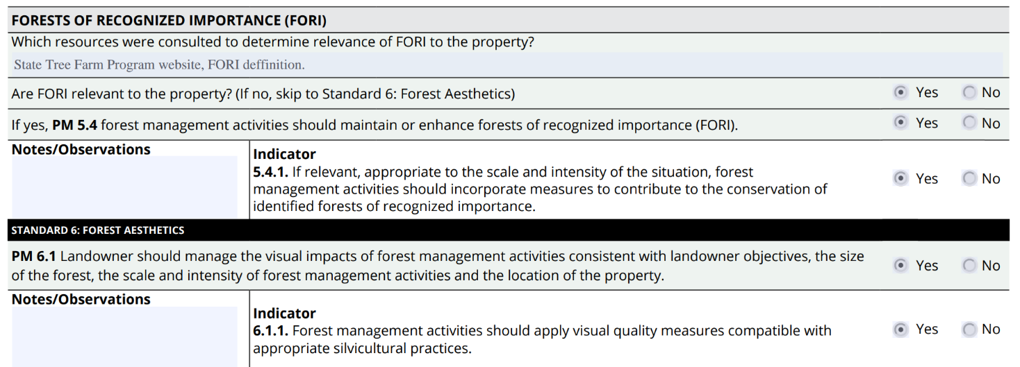
Forest of Recognized Importance
It is important to list any state specific documented resources here- if applicable.

Slide 113
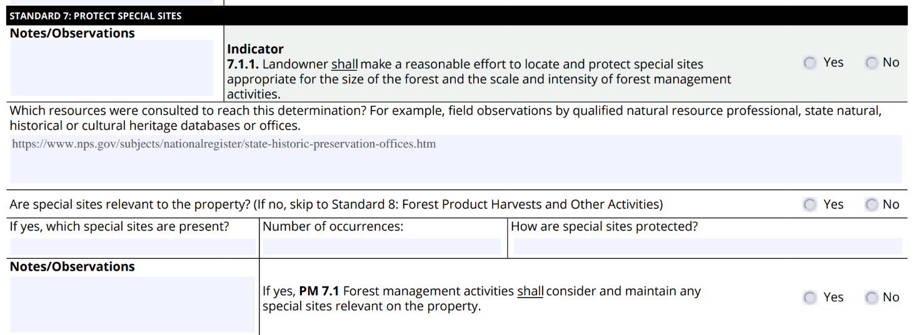
If applicable, list a documented source.

Slide 114
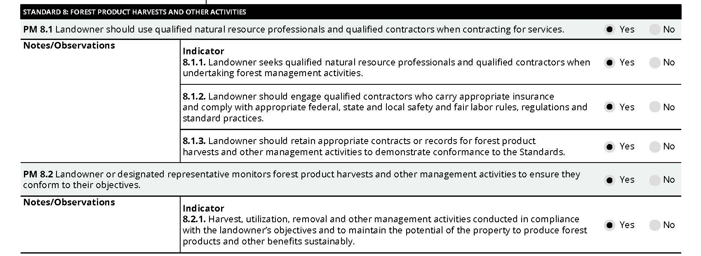

Slide 115

021 Form-
How to obtain a form?
Online-
  Inspector’s Corner
  Database
  Local State Committee guidelines
Notes:
**Add State Committee protocol for obtaining an inspection form

Slide 116
021 Form-
How to submit a form?
Direct Entry
  Inspectors may enter the inspections directly into the ATFS Database and submit for approval.
Email
  Send the writable PDF to inspectors@forestfoundation.org.
  Subject line must contain "upload 021"
  Local State Committee guidelines
Notes:
When emailing the inspection to inspectors@forstfoundation.org the subject line must contain one of the following phrases: upload021, upload 021, upload2021, upload2021, upload 21, upload21, 021 upload, 021upload, 21upload, 21upload, submit 021, submit021, submit 21, submit21.
**Add State Committee protocol for submitting an inspection

Slide 117
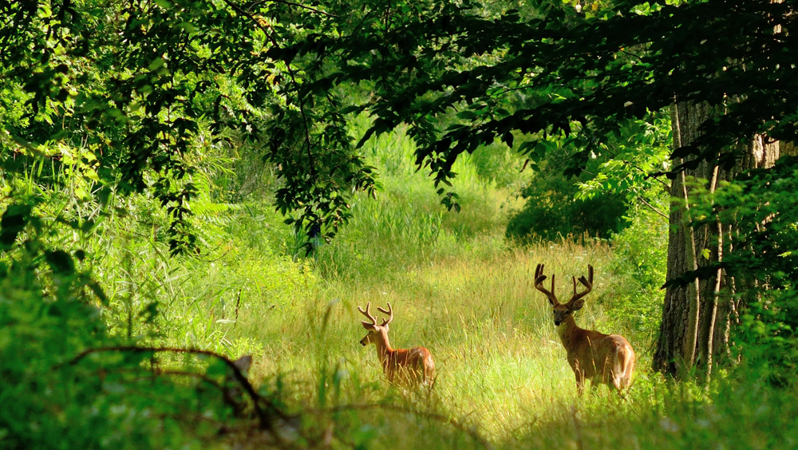

Benefits, Tools, and Resources
Logo
Notes:
Create your own title slide with a different image.
To do so, select the image. Right click. Choose ‘Change Image.’

Slide 118
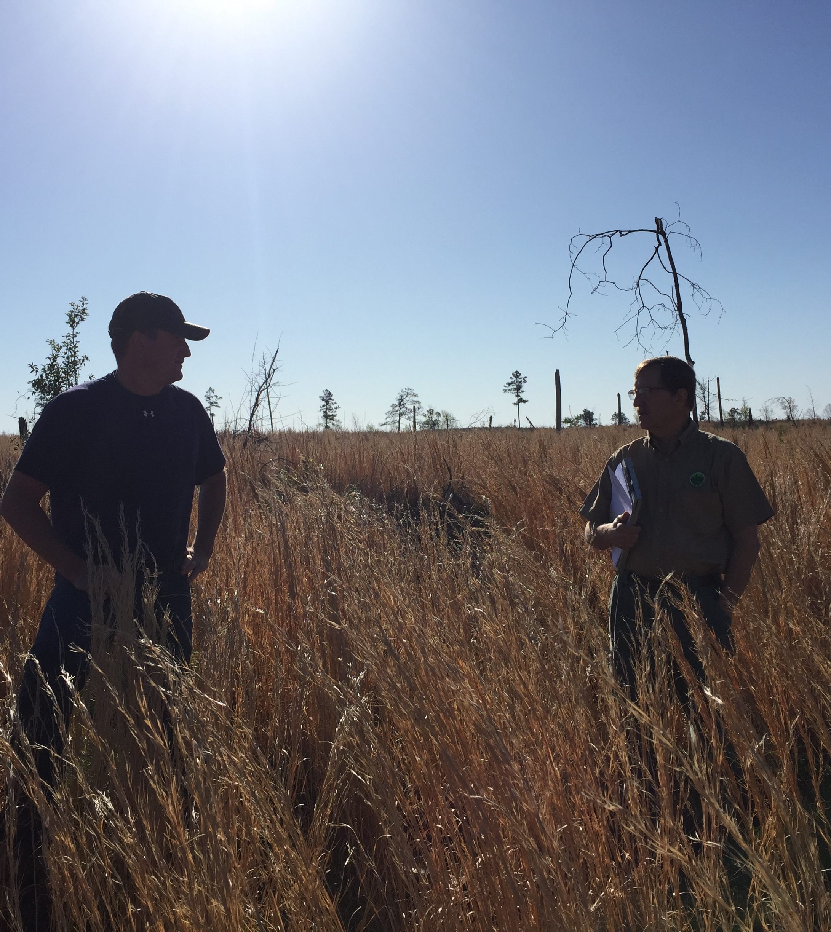

Landowner Benefits
Education
Information
Communication
Community
Certification
Representation
Notes:
Time: 2 minutes
Education
Unique outreach and education opportunities include field days, workshops, newsletters (Forests & Families), webinars.
The State Tree Farm committees are a built-in group of people that Tree Farmers can call upon with questions.
Information on practical sustainable forestry
Connection with a professional, trained inspector
Unique outreach and educational opportunities
State Tree Farm committee support
Materials available/website/print, etc.
The Tree Farm community
Recognition of good management (Tree Farmer of the Year program, Tree Farm sign)
Share experiences and knowledge with other Tree Farmers
Communications
State committee publications – local forestry-related information through newsletters, magazines, emails
Affordable, accessible third-party certification
Third-party certification
Access to markets: green building, certified wood products, and carbon credit trading markets
Representation
State and federal advocacy – working on issues such as the estate tax, cost-share programs through the Farm Bill, carbon credit trading, renewable biomass standards, etc.
Global issues – we partner with PEFC to advocate on behalf of small landowners in the United States to protect their private property rights
Talk about your State specific benefits – talk about what typical opportunities your tree farm committee and partners offer.

Slide 119
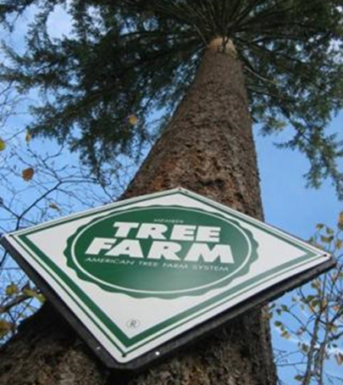
Tree Farm Signs
Landowners can purchase additional signs:
www.treefarmsystem.org/atfssigns
Notes:
Time: 2 minutes
If your state offers signs to landowners- announce that process here.
Suggestions for Erecting Signs:
Erect on roadside at right-of –way to maximize visibility
Clean brush, weeds and trash from base of sign
We recommend that their sign NOT be nailed to a tree because it could damage the tree

Slide 120
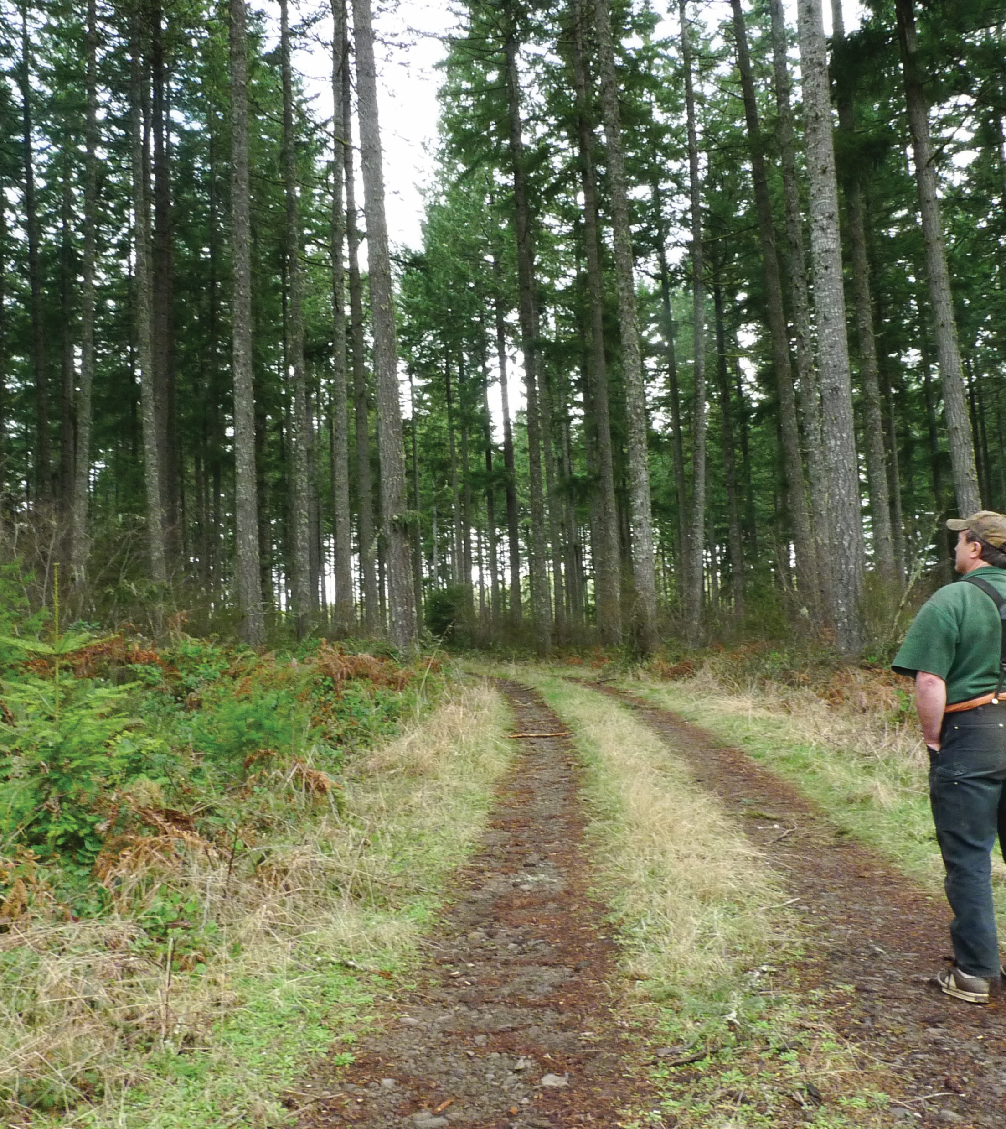
Forester Benefits
Contacts
Landowners and foresters
Recognition
Commitment to Sustainable Forestry
Resource Efficiencies
SFI-SIC
Landowner outreach
SAF CFE Credits
Communications
Notes:
Time: 2 minutes
Talk about your State specific benefits – talk about what typical opportunities your tree farm committee and partners offer for inspectors.
Contacts
Build relationships with local landowners – for consulting and industrial foresters, this is an opportunity to gain new clients
State agency mission to outreach to landowners, supports USFS/AFF agreement of standards
Recognition
Supporting sustainable forest management: Inspectors get to help landowners implement sustainable forestry practices
For you organization’s commitment to sustainable forestry
Opportunity for recognition through various ATFS awards such as the Inspector of the Year state and national awards
Resource efficiencies
SFI SIC – alignment with landowner outreach commitment
State agency, consultants, SIC members, fulfills landowner commitment. Work toward mutual end on landowner outreach commitments.
Recognition of volunteer service
SAF Continuing Forestry Education credits for training workshops
Inspection incentive program
Communications
Newsletter and email updates

Slide 121
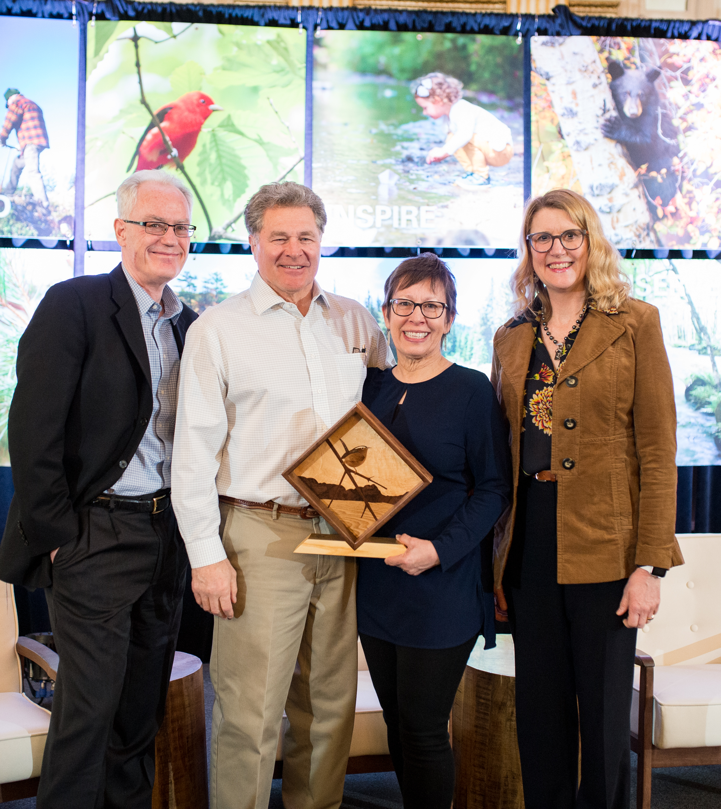
Volunteer Awards
Tree Farmer of the Year
Inspecting Forester of the Year
Leadership Award
These are awarded at a State, Region, and National level.
*Please nominate an outstanding landowner, volunteer, or forester!
Notes:
Time: 1 minute
Materials:
To recognize excellence in our Tree Farmers and Inspectors: State, Regional and National Outstanding Tree Farmers and Inspector of the Year (describe your state’s award/process).

Slide 122
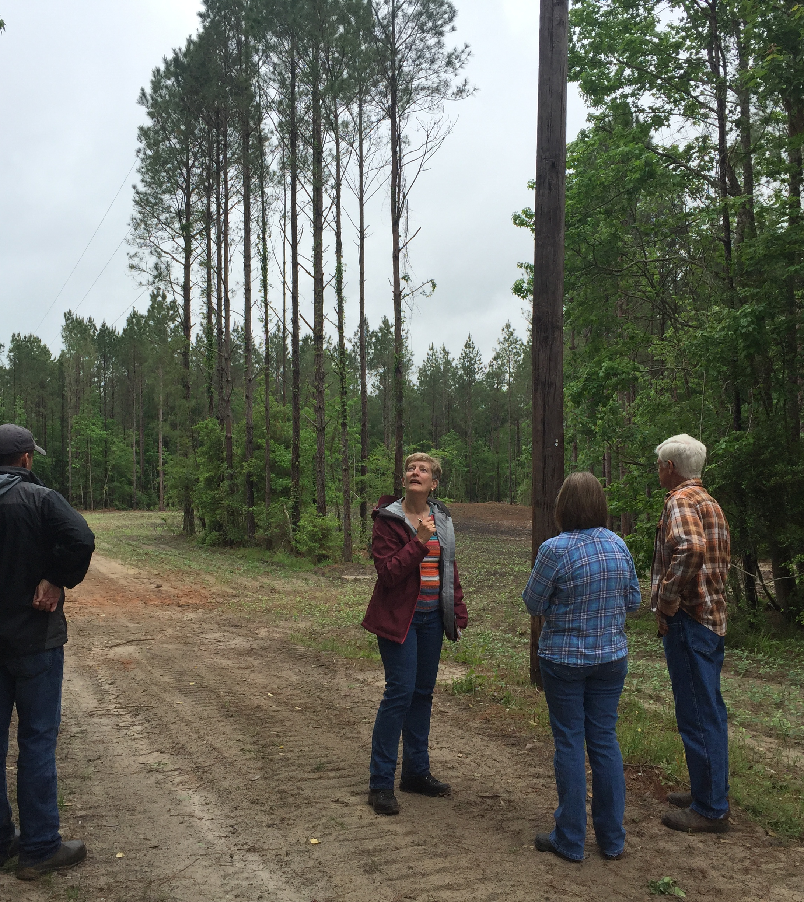
After training, what should I do?
Stay in contact with your state committee and participate in events and outreach
Conduct inspections
Inform landowners about the Tree Farm Program
Need help getting started?
Reach out!
Notes:
Time:
Materials:
You are added to the national database so that you may receive.
Your CFEs will automatically be processed
If you want to do an inspection, don’t be shy! Contact your state Administrator or Chair and let them know you will be doing inspections
Help out at the State level and/or identify at least one landowner or colleague who deserves recognition as either an Inspecting Forester or for Field Leadership

Slide 123
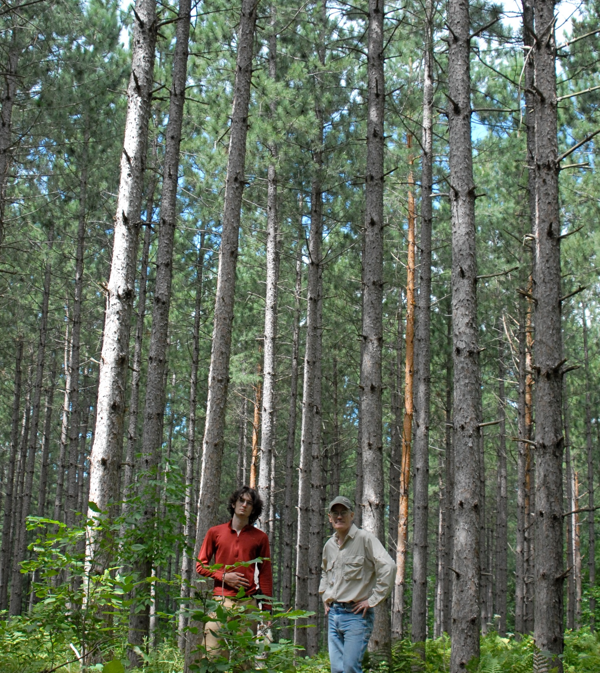
Inspector Policies
Once trained to the 2021 Standards, your credentials will not expire for the life of the Standards
Typical cycle of the standards is 5 years, 2021-2026.
*Database Confidentiality Agreement
*No Harassment Policy
Notes:
Time: 1 min
As a trained inspector you will have access to the ATFS database, but you will be required acknowledge the Confidentiality Agreement and No Harassment Policy

Slide 124

Respect in the Environment
The American Forest Foundation (AFF) is committed to ensuring a safe environment for all involved in and while implementing the American Tree Farm System (ATFS).
This includes:
Volunteers
Partners
Contractors
Staff
Landowners
Others
In support of this commitment and values shared by members of its community, AFF maintains and enforces a policy of zero tolerance for any type of harassment.

Slide 125
Your Role and Responsibility
The American Forest Foundation (AFF) is committed to ensuring a safe environment for all involved in and while implementing the American Tree Farm System (ATFS).
Treat your co-workers with dignity and respect their rights.
Value and leverage the differences in others.
Modify communication and behavior based on individual differences, for fair, equitable and inclusive engagement.
Prevent and protect all employees from discrimination and harassment.
If you hear something, say something.

Slide 126
ATFS Policy: Reporting Harassment
Due to the very serious nature of harassment, discrimination and retaliation, you must report your concerns to one of the individuals listed below:
1. Discuss any concern with the:
Director of ATFS
2000 M St, NW, Suite 550
Washington, DC 20036
If you are not satisfied after you speak with the Director of ATFS, or if you feel that you cannot speak to the Director of ATFS, discuss your concern with:
Director of Human Resources
2000 M St, NW, Suite 550
Washington, DC 20036
Notes:
Additional information about the No Harassment Policy, training resources, and related FAQs are available at treefarmsystem.org/trainings-resources-for-inspectors.

Slide 127
ATFS Staff Contacts
Angela Wells, ATFS Director
awells@forestfoundation.org
Steve Lloyd, ATFS Certification Manager
slloyd@forestfoundation.org
Kayti Wilson, Senior Community Manager
kwilson@forestfoundation.org
Parks Brigman, Community Manager
pbrigman@forestfoundation.org
Kyle Brown, Community Manager
kbrown@forestfoundation.org

Slide 128
State Contacts
Committee
Chair
Program Administrator
District Chair/Inspector
Other (as applicable)
Notes:
Insert your key committee contacts

Slide 129
Registration and Evaluation Form for Today
Notes:
Be sure to collect registration and evaluation forms for the workshop. This may be done on paper or via a web-based survey system.

Slide 130
Questions
Thank you for participating in today’s training!

